Slide 1

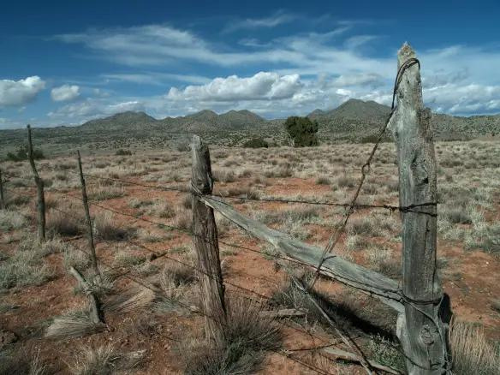
Agriculture Infrastructure Fund (AIF) Program Update
The Navajo Nation
Department of Agriculture

Slide 2


2025 Accomplishments
5 of 7 Priorities Completed
  Reallocated unapproved Year 3 projects
  Completed AIF performance audit
  Integrated AIF into NNDA Plan of Operation
  Updated organizational chart
  Developed Emergency Drought Contingency Plan

Slide 3
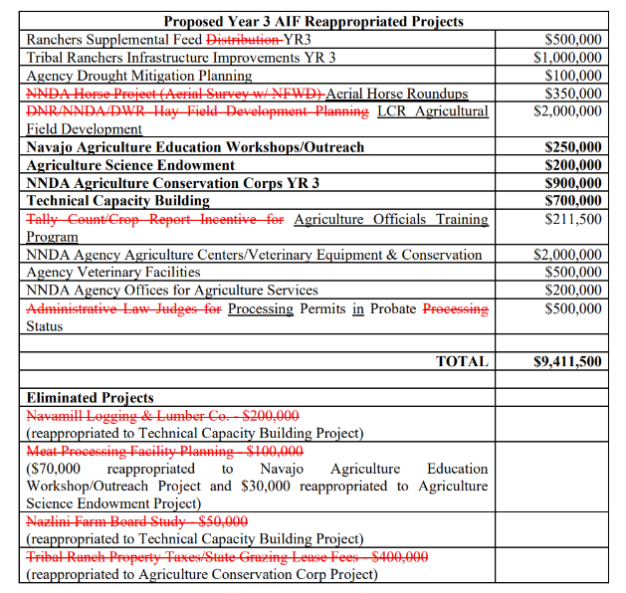
Year 3 Reappropriations
RDCD-40-22 ($35.2M)
$9.411M required reallocation (18 Projects)
  After Internal Review - $750,000 reallocated (4 Projects)
  Funds reassigned to education, endowment, conservation corps, and capacity building
As of April 3, 2025, the Office of Management and Budget has deemed Document No. 026361 AIF Budget Reallocation sufficient, pending adjustment of personnel salaries to the new salary schedule that took effect on October 1, 2025. The document will then be sent to the Office of the Controller and subsequently to the Department of Justice for final review.

Slide 4
Projects Eliminated/Reallocated
&
Proposed Reappropriated Projects
Tribal Ranch Property Taxes/Lease Fees – $400,000
Meat Processing Facility Planning – $100,000
Nazlini Farm Board Study – $50,000
Navamill Lumber & Logging – $200,000
$400,000
Ranchers Supplemental Feed Project – $500,000
Tribal Ranch Infrastructure Improvements – $1,000,000
LCR Agricultural Field Development – $2,000,000
Agriculture Officials Training – $211,500
Veterinary Equipment & Facilities Projects

Slide 5
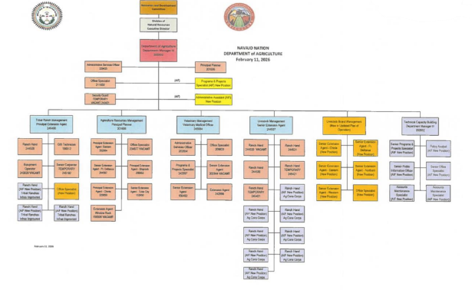
AIF Program Integration
  Added to NNDA Plan of Operation
  Technical Capacity Building Program established
  Positions added:
  Program & Projects Specialist
  Administrative Assistant
  Nine Ranch Hands

Slide 6

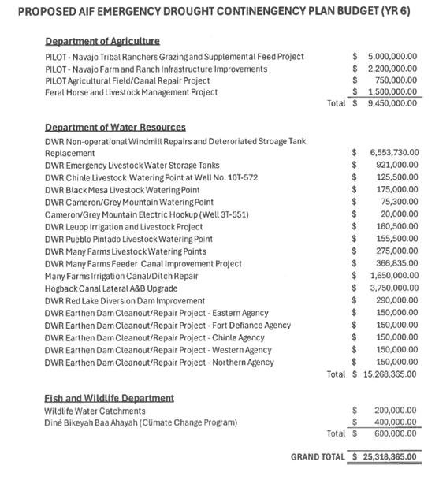
Emergency Drought
Contingency Plan
  Office of Speaker requested drought funding
  Unaudited balance reported: $44.7M
  Proposed allocation: $25.3M
  Proposed allocation: $25.3M
Drought Budget Allocation
  Department of Agriculture: $9.45M
  Department of Water Resources: $15.27M
  Fish & Wildlife: $600K
  Grand Total: $25.318M

Slide 7
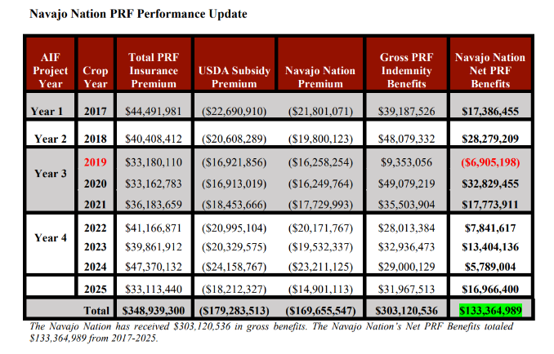
PRF Performance Update
• Gross PRF Benefits (2017–2025): $303.1M
• Net PRF Benefits: $133.4M
• Positive returns in most crop years
2026-2027 Priorities
1. Fill AIF positions
2. Develop AIF policies
3. Amend Fund Management Plan
4. Procure PRF Insurance Agent
5. Extend PRF coverage (2029–2032)
6. Develop Year 4 AIF projects

Slide 8
Thank You
For Attention
Presented By:
Jesse Jim

