Slide 1
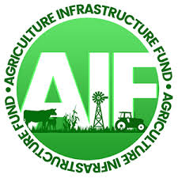
Agriculture Infrastructure Funds Program – What are your benefits?
Navajo Nation Department of Agriculture
Presented to Navajo Sustainable Agriculture Project February 18, 2025, Webinar
NNDA - Agriculture Infrastructure Fund Program

Slide 2
Agriculture Infrastructure Fund Program
Established in 2016 to facilitate agricultural infrastructure development throughout the Navajo Nation, the Navajo Partitioned Lands, and the former Bennett Freeze Area. Approved projects are relative to range management, grazing and livestock management, tribal ranches, fencing, farming and irrigation, agricultural water development, reservoirs, dams and catchments, watershed planning for agriculture, drought contingency and mitigation plans, and branding of livestock.
The AIF is a source of funds for agriculture infrastructure projects on the Navajo Nation. Funds are made available through IDEMNITY PAYMENTS received from the Nation's participation in the USDA Risk Management Agency’s Pasture, Rangeland, Forage (PRF) Insurance Program.
Legislation CO-57-16 authorized the Navajo Nation, through its Division of Natural Resources and Department of Agriculture to enroll in the "Rainfall Index Pasture, Rangeland, and Forage Pilot Insurance Program" administered by the United States Department of Agriculture.
NNDA - Agriculture Infrastructure Fund Program

Slide 3
Pasture, Rangeland and Forage Insurance Program (PRF Insurance)
Provided by the USDA Risk Management Agency.
The PRF policy is an area-based insurance plan that covers perennial pasture, rangeland, or forage used to feed livestock. It provides producers a risk management tool to cover the precipitation needed to produce forage for their operation.
Area-based means payments are not based on an individual producer's experience; rather, payments are based on a grid’s deviation from normal experience. For example, under the Rainfall Index, if your ranch received a surplus of rain, but the area in your grid was below average, you could receive a payment or vice versa.
NNDA - Agriculture Infrastructure Fund Program

Slide 4
How can I apply to participate in the PRF Insurance Program?
The Navajo Nation has set up one policy for all Navajo Ranchers since 2016 for all ”trust land” within Arizona, New Mexico, and Utah to apply for PRF Insurance.
Navajo Nation is registered as one farm/ranch within the USDA Farm Service Agency excluding the Navajo Farmers and Ranchers that participate directly with FSA.
Individual “Grazing Permittees” located on Navajo Nation trust land do not pay annual grazing fees, this disqualifies individual Navajo ranchers to participate in PRF due to land ownership status.
“Allottees” located on Indian Allotments and ”lessees” located on Fee Lands can participate within their own policy.
NNDA - Agriculture Infrastructure Fund Program

Slide 5
Navajo Nation PRF Insurance Agency and Insurance Agent
CO-57-16 (CAP-16-24 and CMY-54-18) allows the Division of Natural Resources and Navajo Department of Agriculture have the authority to :
Lawfully procure an PRF Insurance Agency to represent the Navajo Nation in obtaining drought insurance by adhering to all Navajo Nation policies.
Navajo Business Opportunity Act
Navajo Procurement Act
Manage, administer and implement the Agriculture Infrastructure Fund (AIF) projects on the Navajo Nation accordingly.
The 23rd Navajo Nation Council approved and adopted the AIF Fund Management Plan through legislation RDCAU-74-18 to begin spending of the PRF indemnity payments for identified AIF annual projects.
AIF Projects approved by Navajo Nation Council legislations:
RDCD-100-18 – Year 1 AIF Projects
RDCD-100-18 – Year 2 AIF Projects
RDCD-40-22 – Year 3 AIF Projects
NNDA - Agriculture Infrastructure Fund Program

Slide 6
Annual PRF Premium Payment
To participate in the PFR Insurance Program, the Navajo Nation is required to pay an annual insurance premium utilizing Síhasin Fund.
USDA covers between 51% and 59% dependent on coverage selection of the premium cost for the Navajo Nation (90% coverage).
CMY-54-18 amended CO-57-16 to extend the Síhasin Fund reserve and guarantee for an additional five years through the end of the 2023 crop year.
Most recently, in 2024 CAP-16-24 amended CMY-54-18 to extend the Nation’s PRF participation through crop year 2028, and to designate $10,845,641 to come from the Síhasin Fund guarantee and $9,000,000 from AIF’s uncommitted net revenues for the Navajo Nation’s annual premium for the PRF insurance program.
NNDA - Agriculture Infrastructure Fund Program

Slide 7
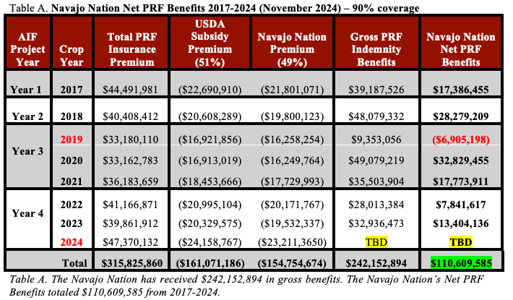
NNDA - Agriculture Infrastructure Fund Program

Slide 8
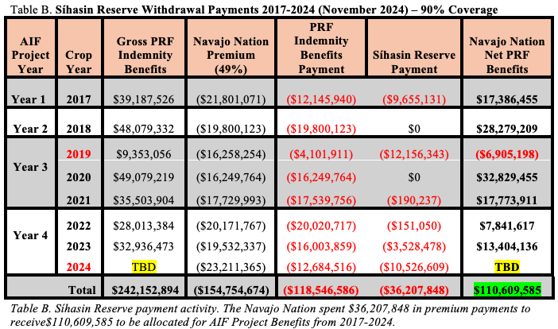
NNDA - Agriculture Infrastructure Fund Program

Slide 9
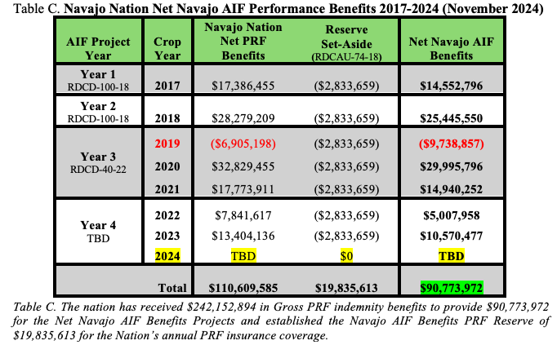
NNDA - Agriculture Infrastructure Fund Program

Slide 10
What are your AIF Benefits?
AIF Projects are developed to assist grazing permittees and land use permittees annually through financial and direct services to continue cattle and sheep production and agriculture production on the Navajo Nation to contribute to the U.S beef, sheep, and wool industries through allowable ranching and farming projects to improve the Navajo Nation ranching and farming communities to be self sustaining.
Improving ranching practices
Supplemental Feeding programs to allow Navajo rangelands to rest and rotate livestock.
Tribal Ranches Infrastructure projects to improve tribal ranches to rotate Navajo cattle onto Arizona Tribal Ranches seasonally.
Area wide fencing – assisting fence building material
Improving farming and irrigation practices
agriculture water repairs and development (dams, reservoirs, catchments)
watershed planning for agriculture
drought contingency planning
Administrative Costs
Brand Management Program
Horse Management Program
NNDA - Agriculture Infrastructure Fund Program

Slide 11
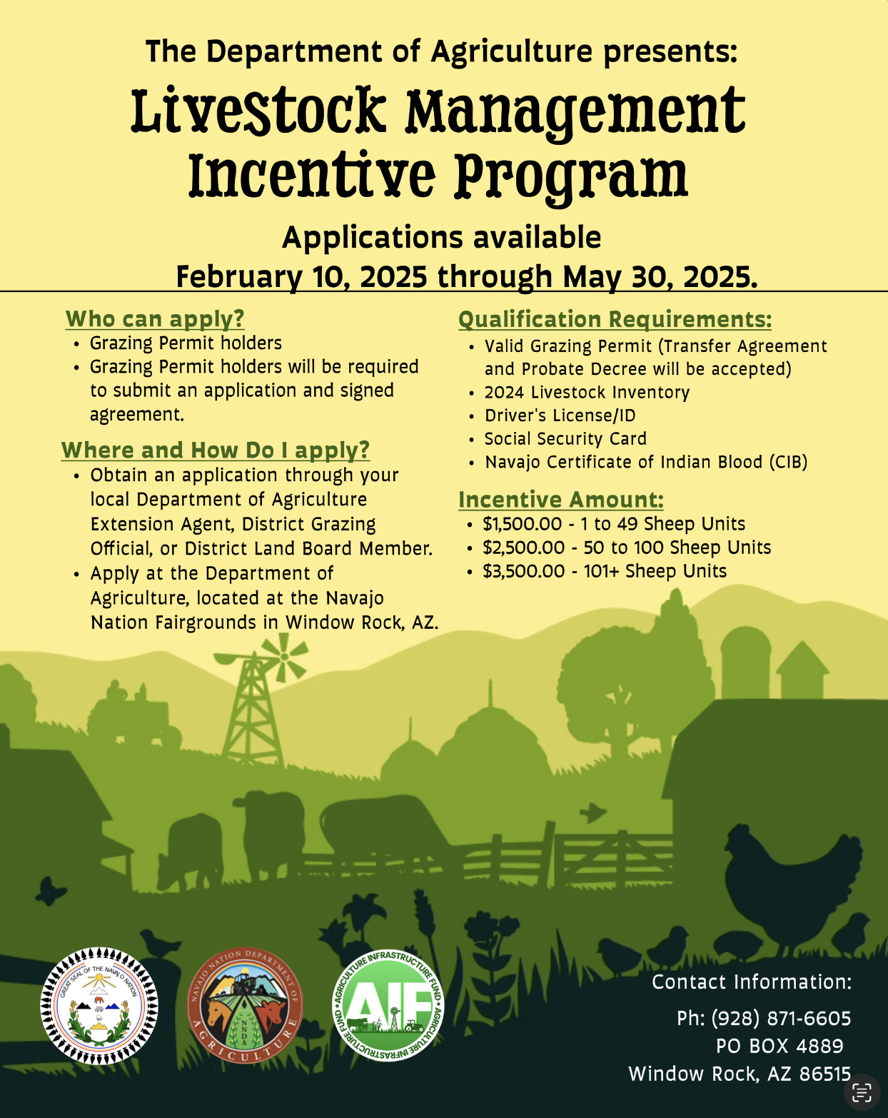
What are your AIF Benefits continued…
2. AIF Incentive Payment Programs
Livestock Management Incentive
1-49 SUYL receive $1,500
50-100 SUYL receive $2,500
101+ SUYL receive $3,500
Farm and Garden Incentive
Land Use Permittee receive $1,000
Gardeners receive $500 (non-LUP holders)

Slide 12
Pasture range forage expenditure plan fund categories
Range, Grazing and Livestock
Tribal Ranches Infrastructure Improvements
Farming and Irrigation
Agricultural Water Development
Watershed planning for agriculture
Drought Contingency Planning
Area-wide Fencing
Brand Office, Navajo Partitioned Lands & Former Bennett Freeze Area Projects
Agricultural Complexes
NNDA - Agriculture Infrastructure Fund Program

Slide 13
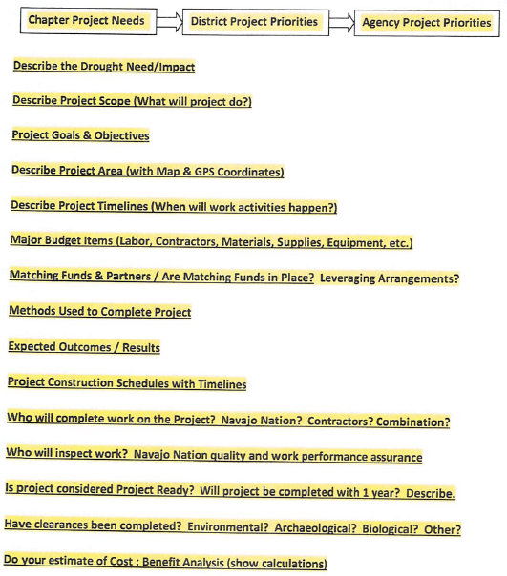
Project proposal submissions (2018-2023)
Agency agriculture priority lists submitted by Agency Grazing committees, Major Irrigation Farm Boards, Eastern Joint Land Board to Navajo Department of Agriculture.
Project Proposals submitted by non-profit organizations, chapters, farmers, ranchers, Navajo Nation Council members, and DNR Departments.
NNDA - Agriculture Infrastructure Fund Program

Slide 14
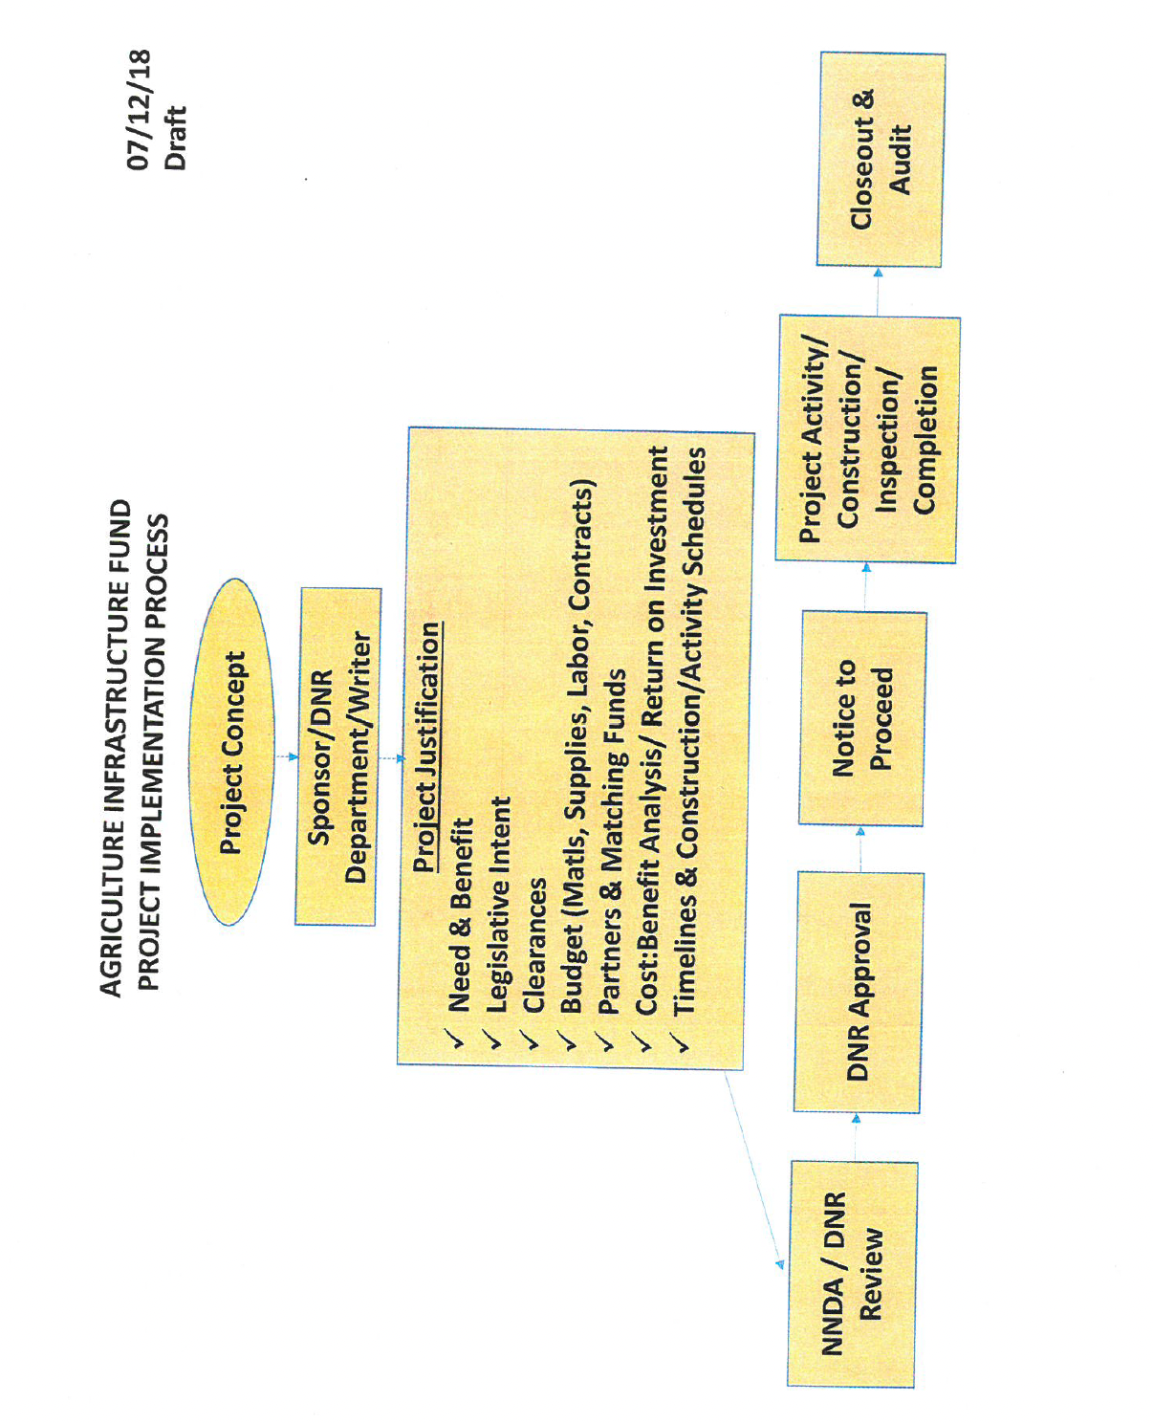
NNDA - Agriculture Infrastructure Fund Program

Slide 15
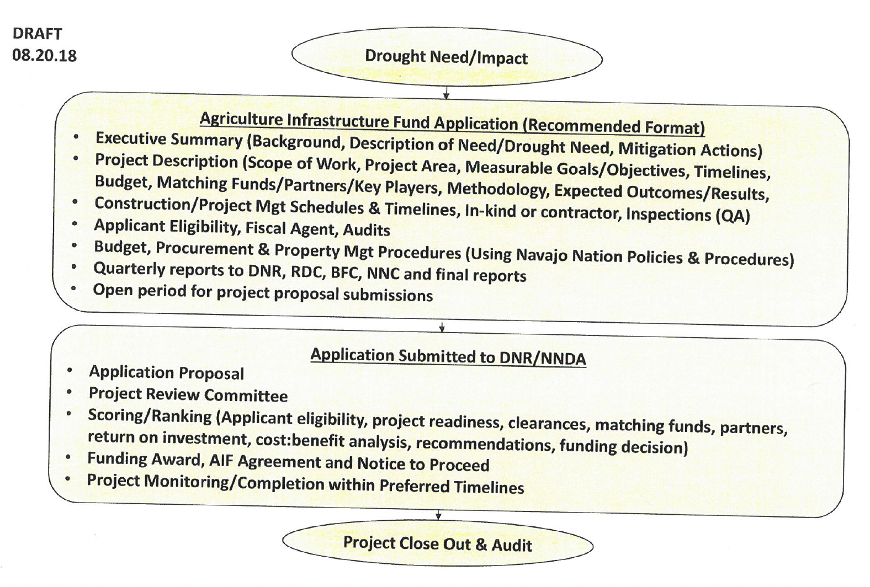
NNDA - Agriculture Infrastructure Fund Program

Slide 16
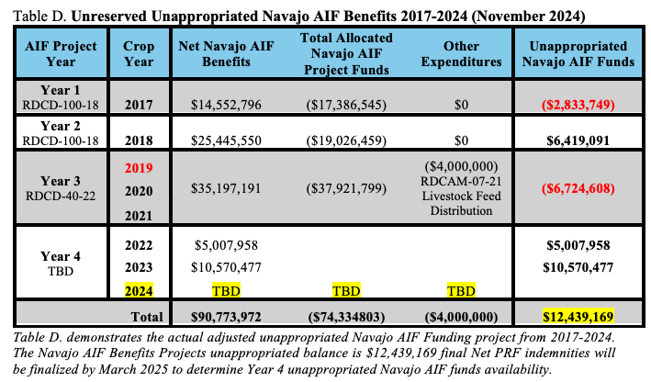
NNDA - Agriculture Infrastructure Fund Program

Slide 17
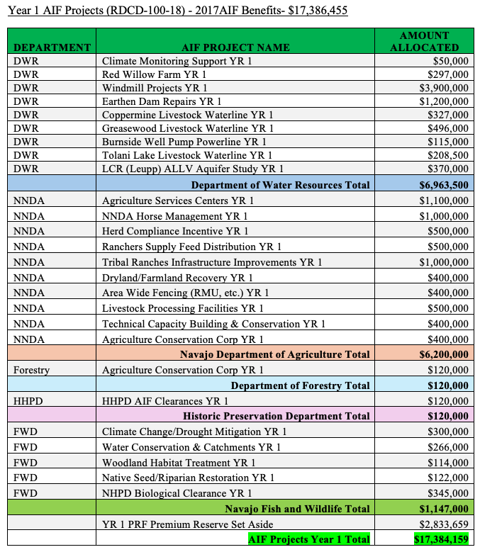
NNDA - Agriculture Infrastructure Fund Program

Slide 18
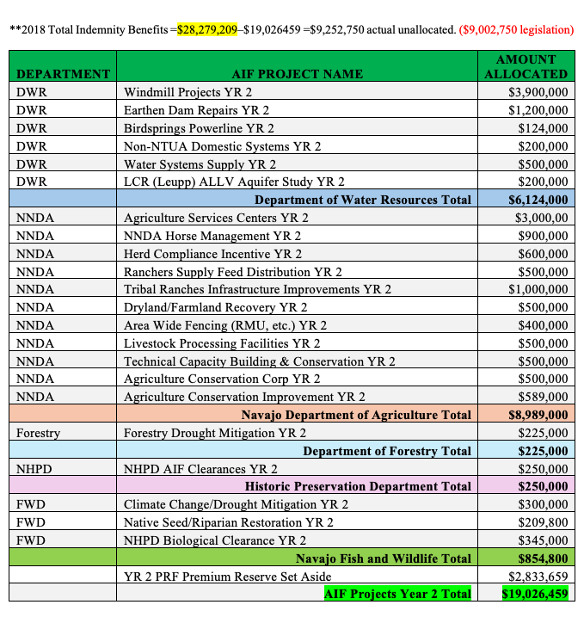
NNDA - Agriculture Infrastructure Fund Program

Slide 19
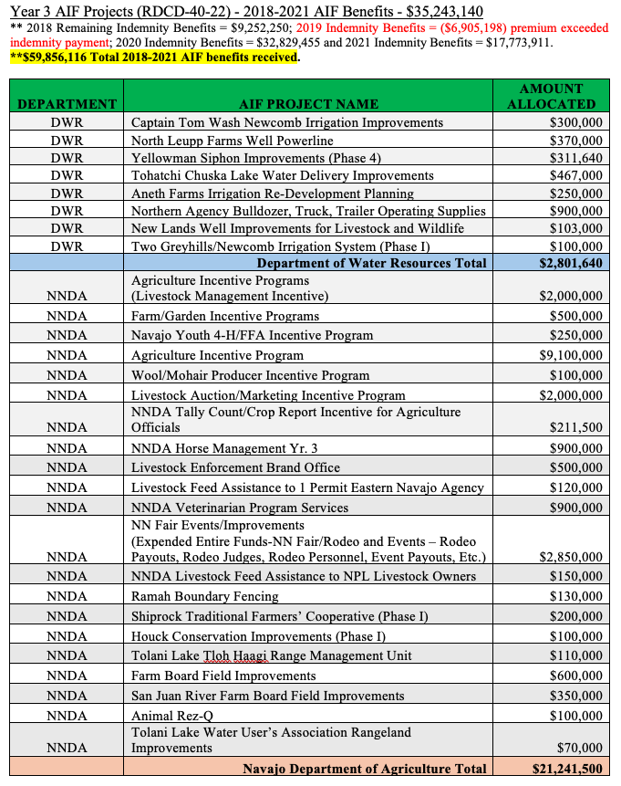
NNDA - Agriculture Infrastructure Fund Program

Slide 20
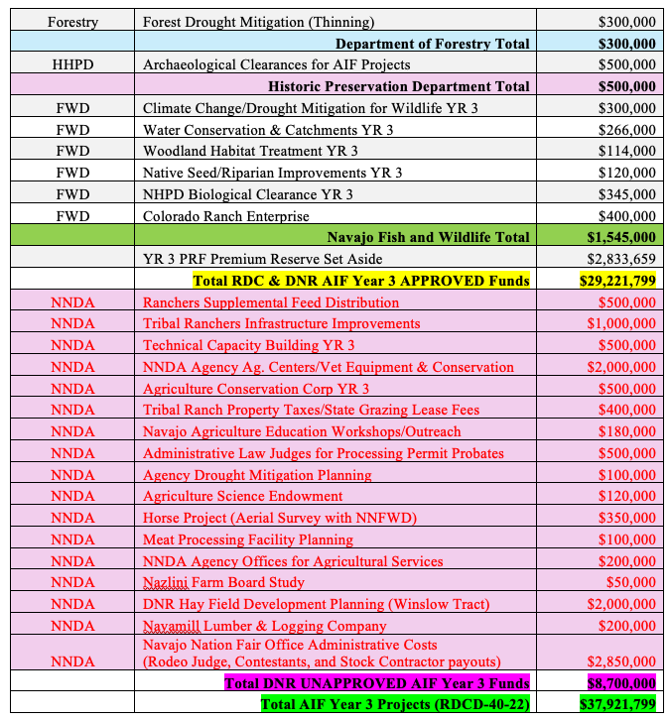
NNDA - Agriculture Infrastructure Fund Program

Slide 21
25th Navajo Nation council budget and finance committee
2024 Navajo Nation Council Winter Session
Delegate Amber Crotty request performance audit on AIF Project Programs.
NNDA - Agriculture Infrastructure Fund Program

Slide 22
Questions?
NNDA - Agriculture Infrastructure Fund Program

Slide 23
Thank you
Navajo Department of Agriculture
PHONE: 928-871-6605
Ms. Jesse Jim, Department Manager III
Jesse.Jim@navajo-nsn.gov
Cordell Smith, AIF Administrative Assistant
Cordell.Smith@navajo-nsn.gov
NNDA - Agriculture Infrastructure Fund Program

