Slide 1
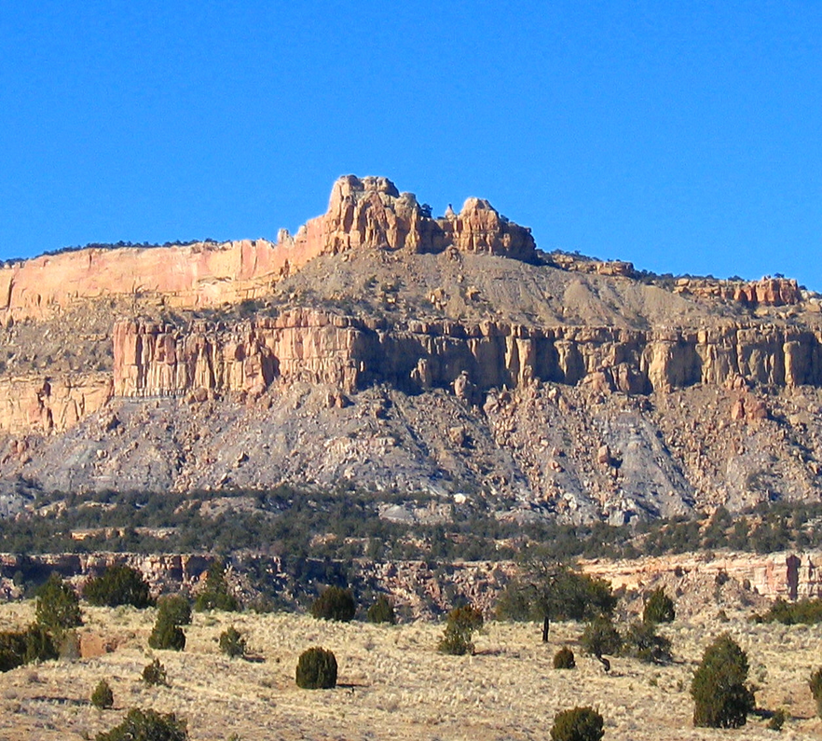
Bonding Requirement
BIA-Eastern Navajo Agency, Branch of Natural Resources March 28, 2024, 5:30p.m. (MDT)
New Mexico State University
Navajo Sustainable Agriculture

Slide 2
Authorities
The American Indian Agricultural Resource Management Act, 1993 (As Amended)
25 Code of Federal Regulations Parts 162 (Leasing), 166 (Grazing Permits) and 167 (Navajo Grazing Regulations)
Title 3 Navajo Nation Code

Slide 3
Title 3 Navajo Nation Code
§ 945. Bonding and insurance requirements
A. A satisfactory performance bond may be required in an amount that will reasonably assure performance of the contractual obligation. A bond, when required, may be for the purpose of guaranteeing the estimated construction cost of any improvement to be placed on the land which will become the property of the permitter or to insure compliance with special or additional contractual obligations.
B. The permittee may be required to provide insurance in an amount adequate to protect any improvement on the permitted premises; and may also be required to furnish appropriate liability insurance and such other insurance as may be necessary to protect the permitter's interest.

Slide 4
25 Code of Federal Regulations PART 166—GRAZING PERMITS §166.600 – §166.607 Bonding and Insurance Requirements
Bond means security for the performance of certain permit (lease) obligations, as furnished by the permittee (tenant), or a guaranty of such performance as furnished by a third-party surety.
Surety means one who guarantees the performance of another.

Slide 5
Bonding Requirement
A bond is a guaranty of performance that may be furnished by the permittee or a third-party surety. The purpose of bonding is to ensure compliance with the terms of the grazing permit. A bond must be secured in all permit situations, except
when otherwise provided by a tribal resolution; or
at the request of the majority interest owners and BIA determination that waiver is in the best interest of the Indian landowner(s).
It is advisable to require a bond when a permit obligates significant improvements, or when there is risk of damage to the permitted property or risk that the permittee will not perform the obligations of the permit.

Slide 6
Bonding Requirement
If a violation results in forfeiture of a performance bond, the funds are applied to remedy damages and the permittee is required to post a replacement bond. If no violation occurs during the permit term, the bond is returned to the permittee.
Additionally, when necessary to protect the Indian landowners, the permittee is required to provide insurance. This insurance may include liability and/or casualty (fire, hazard, flood, etc.). If insurance is required, the policy must identify both the Indian landowners and the United States as insured parties and must be provided in an amount adequate to protect all insurable improvements on the leased premises.

Slide 7
25 CFR Part 166, Subpart G—Bonding and Insurance Requirements
166.600 - Must a permittee provide a bond for a permit?
166.601 - How is the amount of the bond determined?
166.602 - What form of bonds will the BIA accept?
166.603 - If cash is submitted as a bond, how is it administered?
166.604 - Is interest paid on a cash performance bond?
166.605 - Are cash performance bonds refunded?
166.606 - What happens to a bond if a violation occurs?
166.607 - Is insurance required for a permit?
166.608 - What types of insurance may be required?

Slide 8
§ 166.600 Must a permittee provide a bond for a permit?
Yes! A permittee, assignee or sub-permittee must provide a bond for each permit interest acquired. Upon request by an Indian landowner, we may waive the bond requirement.
What is the definition of a bond?
A bond represents a promise by a borrower (permittee) to pay a lender (financial institution) their principal and usually interest on a loan. Bonds are issued by governments, municipalities, and corporations.
An insured coverage in an amount that will reasonably assure performance of the contractual obligation.

Slide 9
§ 166.601 How is the amount of the bond determined?
The amount of the bond for each permit is based on the:
Value of one year’s grazing rental payment;
It could be first and last year’s annual payment.
Value of any improvements to be constructed;
e.g., Fences, cattle guard, earth dams, water stock lines, windmills, corrals, buildings.
Cost of performance of any additional obligations; and
Definition: A performance bond is a financial guarantee to one party in a contract against the failure of the other party to meet its obligations. It is also referred to as a contract bond. A performance bond is usually provided by a bank or an insurance company to make sure a permittee performs to its obligations to the terms of the conservation plan and terms of the grazing permit.
Financial institution will determine the cost.
Obligation: Use of rangeland for commercial livestock, raising, pasturing, and grazing of livestock solely.

Slide 10
§ 166.601 How is the amount of the bond determined?
Cost of performance of restoration and reclamation.
Definition: Reclamation is the restoration of the land to its original condition and replanting after the land has been over grazed.
Financial institution will determine the cost.
It ensures when range land reaches the end of its purposeful term, the land is restored to its former and/or an acceptable condition and monitoring necessary as reclamation is completed.
Tribal policy made applicable by § 166.100 of this part may establish or waive specific bond requirements for permits.
The Navajo Nation and/or individual Indian landowners could request to waive the bond requirements for approval by the Regional Director if it is in the best interest of the landowner.

Slide 11
§ 166.602 What form of bonds will the BIA accept?
(a) We will only accept bonds in the following forms:
(1) Cash
A cash bond is when you post cash through a financial institution to fulfill your obligations. The advantage to the principal of a cash bond is a lower fee.
Cash, Certified Check, or Bank Draft (Guaranteed Remittance): In an amount equal to the required dollar amount of a financial guarantee, and to be deposited and maintained in a Federal depository account of the United States Treasury by the BIA payable to the Department of the Interior, Bureau of Indian Affairs. Personal and foreign checks are not accepted.
The cash bond is listed in the non-trust Suspense Deposit System and does not earn interest for the term of the deposit.

Slide 12
§ 166.602 What form of bonds will the BIA accept?
(2) Negotiable Treasury securities that:
Definition: Negotiable instruments refer to securities whose ownership is easily transferable from one party to another. Negotiable securities are considered liquid, meaning they can easily be transferred or sold in the market.
Negotiable instruments include certificates of deposit and currency, e.g., include bank checks, promissory notes, and bills of exchange.
Have a market value equal to the bond amount; and
Definition: Establish a market value at the time of deposit of no less than the dollar amount for bonding.
(ii) Are accompanied by a statement granting full authority to the BIA to sell such securities in case of a violation of the terms of the permit.
Definition: A statement within the agreement and/or contract bond.

Slide 13
§ 166.602 What form of bonds will the BIA accept?
(3) Certificates of deposit [or CD] that indicate on their face that Secretarial approval is required prior to redemption [recovery] by any party;
Definition: a type of savings account offered by a federally insured (FDIC) bank and credit union. You generally agree to keep your money in the CD without taking a withdrawal for a specified length of time with a fixed interest rate; withdrawing money early means paying a penalty fee to the bank; the financial institution may require a minimum deposit or proof of business filing.

Slide 14
§ 166.602 What form of bonds will the BIA accept?
(4) Irrevocable letters of credit (LOC) issued by federally-insured financial institutions authorized to do business in the United States. LOC’s must:
(i) Contain a clause that grants the BIA authority to demand immediate payment if the permittee defaults or fails to replace the LOC within 30 calendar days prior to its expiration date;
(ii) Be payable to the ‘‘Department of the Interior, BIA’’;
(iii) Be irrevocable during its term and have an initial expiration date of not less than one year following the date we receive it; and
(iv) Be automatically renewable for a period of not less than one year, unless the issuing financial institution provides the BIA with written notice at least 90 calendar days before the letter of credit’s expiration date that it will not be renewed;

Slide 15
§ 166.602 What form of bonds will the BIA accept?
(5) Surety bond; or
A surety bond is a promise to be liable for the debt, default, or failure of another.
It is a three-party contract by which one party (the surety) guarantees the performance or obligations of a second party (the principal) to a third party (the obligee).
PRINCIPAL: Person required to post bond.
OBLIGEE: Government entity or person requiring principal to be bonded.
SURETY: Provides financial guarantee to obligee on behalf of principal.
(6) Any other form of highly liquid, non-volatile security subsequently approved by us that is easily convertible to cash by us and for which our approval is required prior to redemption by any party.
(b) Indian landowners may negotiate a permit term that specifies the use of any of the bond forms described in paragraph (a) of this section.
(c) A tribe may accept and hold any form of bond described in paragraph (a) of this section, to secure performance under a permit of tribal land.

Slide 16
Subpart G—Bonding and Insurance Requirements
§ 166.603 If cash is submitted as a bond, how is it administered? (this section is self-explanatory)
If cash is submitted as a bond, we will establish an account in the name of the permittee and retain it.
§ 166.604 Is interest paid on a cash performance bond?
No. Interest will not be paid on a cash performance bond.
§ 166.605 Are cash performance bonds refunded?
If the cash performance bond has not been forfeited for cause, the amount deposited will be refunded to the depositor at the end of the permit period.
§ 166.606 What happens to a bond if a violation occurs?
We may apply the bond to remedy the violation, in which case we will require the permittee to submit a replacement bond of an appropriate amount.

Slide 17
Subpart G—Bonding and Insurance Requirements
§ 166.607 Is insurance required for a permit?
When we determine it to be in the best interest of the Indian landowners, we will require a permittee to provide insurance. If insurance is required, it must:
(a) Be provided in an amount sufficient to:
(1) Protect any improvements on the permit premises;
(2) Cover losses such as personal injury or death; and
(3) Protect the interest of the Indian landowner.
(b) Identify the tribe, individual Indian landowners, and United States as insured parties.
§ 166.608 What types of insurance may be required?
We may require liability or casualty insurance (such as for fire, hazard, or flood), depending upon the activity conducted under the permit.

Slide 18
Enhanced Grazing Permit Approval Process
Animal Unit Months
Encode Contract
Submission of required documents (CFR & NN Code)
Submission of new grazing permit application
RFLBA form (NNDA)
Livestock Inventory Receipts (tally sheet)
Conservation plan
Brand card(s)
Certificate of Indian Blood (CIB)
Client referral phase
Generate Rental Rate
Carrying Capacity Analysis (BIA-BNR)
Consultation with the District Land Board (DLB)
BIA-BNR Recommendation
DLB Decision by Resolution
DLB Meeting Minutes
Approve Contract
Generate Invoice
Payment Received
Bond
§ 941; § 944 § 708; § 781; § 784; § 785 25 CFR 166, Subpart B,
Subpart C, and Subpart D
Decision Document approval, CEER Checklist
Agency Superintendent authorizes permit
Issue Grazing Permit
NEPA Process (BIA-BNR)
Applicant Orientation
Tribal process information (NNDA)
25 CFR 166 or 167
Review by NRO, Approval by Superintendent
Regional Archeologist
Environmental Professional
Regional OEC Reviewer
Agency Superintendent
Notes:
Protective Action Projects have to be substantially as described in the EA. Something not described would require separate NEPA analysis.
Step 1: Prepare a list of all Permittees qualified to approve their grazing permit
Step 2: Review lists by specialists and technicians
Step 3: Mail formal letters to current Permittees in good st0anding to submit Application for Allocation of Grazing Privileges (Form 5-5524) and required documents
Step 4: Receive required grazing permit documents
Step 5: Certify all documents for new grazing permit
Step 6: Certify all documents for a permit approval
Step 7: Natural Resource Manager approves Trust Asset and Accounting Management System (TAAMS) Range Contract
Step 8: By November 15, generate invoice(s) in TAAMS for trust lands to the “Primary” Permittee
Step 9: After November 15, generate a manual invoice for all non-trust lands and mailed to the “Primary” Permittee
Step 10: Receive payment and schedule Permittee(s) orientation
Step 11: Complete grazing permit orientation for Permittee(s)
Step 12: Secure signature of Permittee(s) for grazing permit
Step 13: Secure signature of the Permittee for Permittee Responsibility Agreement
Step 14: Submit grazing permit to Agency Superintendent for processing NEPA Compliance (this is where the EA is used!)
Step 15: Conduct quality check for Land Board Action forms and resolutions for finalization, as well as checking for required documents.
Step 16: Ensure Agency Superintendent signs the grazing permit and the Permittee Responsibility Agreement, and provide an original copy of both documents to the Permittee(s)
Upon completion of all steps, the District Permittee list is updated to include the grazing community, range unit number, Permittee’s name, acreages, and carrying capacity. The list is provided to the District Land Board and the Navajo Nation Department of Agriculture.

Slide 19
Available Bonding Companies / Insurance Companies / Banks
Available Bonding Companies
Viking Bond Service
Toll Free: 1-888-2-SURETY (1-888-278-7389) Phone: (623) 933–9334 Fax: (623) 399–1846 Mailing Address: P.O. Box 41460
Phoenix, AZ 85080
Surety Bonds
Toll Free: (800) 308-4358
Mailing Address:
803 E. Walnut St., 5th. Floor
Columbia, MO 65201
Email. customercare@suretybonds.com
Worldwide Insurance Specialist Inc.
Toll Free: (888) 518-8011
Mailing Address:
13341 W. Indian School Rd.,
Suite 305, Litchfield Park, AZ.
Email: sub@wwwisinc.com
Available Banks:
Pinnacle Bank
Telephone: (505) 722-4411
Fax: (505) 722-6731
Mailing Address:
107 East Aztec
Gallup, New Mexico 87301
Email: mhorn@pinnbank.com
Byrant Surety Bonds
Toll Free: (866) 450-3412
Fax: (866) 450-3414
Mailing Address:
132-A Veterans Lane #36
Doylestown, PA 18901
Surety1 – Assured Partners of California Insurance Services LLC
Toll Free: (877) 654-2327
Fax: (916) 737-5737
Mailing Address:
3225 Monier Circle, STE 100 Rancho Cordova, CA 95742
Email: info@surety1.com
Surety One, Inc.
Toll Free: (800) 373 2804
Fax: (919) 834 7039 Mailing Address:
5 W Hargett St, 4th Floor,
Raleigh NC 27601
Email: SuretyOne.com
Available Insurance Companies
C-R Insurance
Telephone: (505) 863-3289
Mailing Address:
401 West Coal Avenue B
Gallup, New Mexico 87301
Email: info@c-rinsurance.com
State Farm Insurance
Telephone: (505) 863-9361
Mailing Address:
1615 S. Second Street
Gallup, New Mexico 87301-5816
Email: gibby@agentgibby.com
Clay Foutz Insurance
Telephone: (505) 722-4476
Mailing Address:
201 E. Aztec Avenue
Gallup, New Mexico 87301
Email: ashley@clayfultz.com

Slide 20
QUESTIONS?

Slide 21
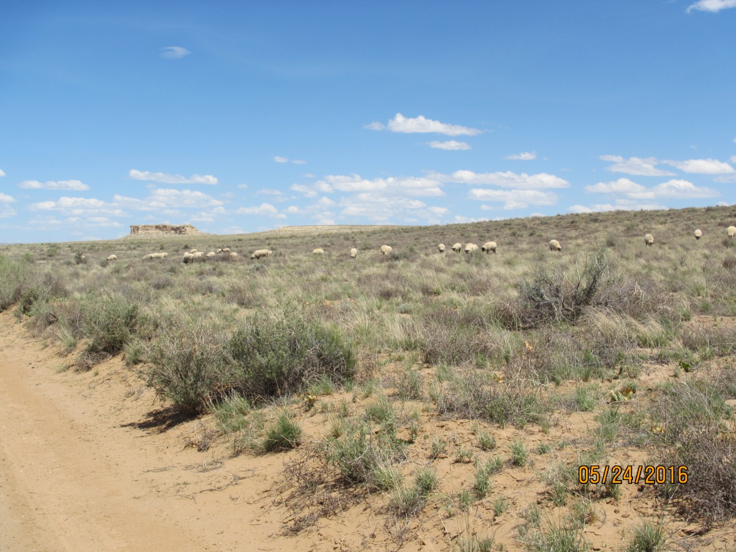
Contact Information
For more information, contact:
Bureau of Indian Affairs
Eastern Navajo Agency
Branch of Natural Resources
(505) 786 – 6100

