Slide 1

Introduction:
National & New Mexico AgrAbility Project
Tracy Agiovlasitis
NMTAP Project Partner
Sonja Koukel
NMSU Project Co-Director

Slide 2

National AgrAbility Project
Renewing Hope, Restoring Productivity
Established through the 1990 Farm Bill
Support, Funding, and Oversight comes from USDA NIFA
(US Department of Ag National Institute of Food and Agriculture)
Led by Purdue University’s Breaking New Ground Resource Center
AgrAbility consists of the National and State/Regional Projects
Funding awarded to land grant universities
State projects must be partnerships between a land grant university and at least one nonprofit disability organization
Source: www.agrability.org
Notes:
Last Bullet:
Agricultural expertise is provided through the university, and the nonprofit provides disability expertise.
Some nonprofits: Easterseals, Goodwill, Arthritis Foundation, United Cerebral Palsy, Osteroarthritis Action Alliance, and AgriSafe Network.

Slide 3
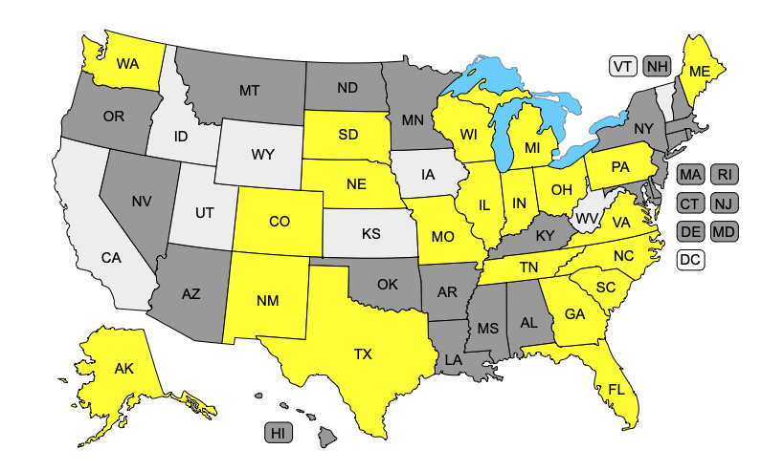
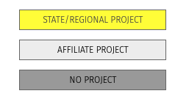
State AgrAbility Projects (2023)
Source: http://www.agrability.org/contact-lists/
Notes:
Due to funding limitations, there are only 21 currently funded state projects, plus the National Project (Purdue) whose purpose is to support the state projects and provide limited services to ag workers in states without AgrA projects.

Slide 4
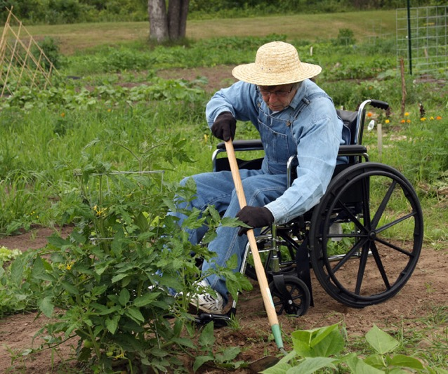
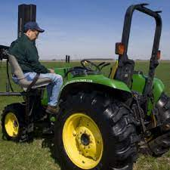
AgrAbility Mission
To enable a high-quality lifestyle for farmers, ranchers, and other agricultural workers with disabilities
To eliminate (or at least minimize) obstacles that block success in production agriculture or agriculture-related occupations through education and assistance

Slide 5
AgrAbility serves agricultural workers who are limited by any type of physical, cognitive, or illness-related disability including but not limited to:
Amputation
Arthritis
Back impairment
Deafness/hearing impairment
Developmental disabilities, such as cerebral palsy or autism
Disabling diseases, such as cancer or heart disease
Mental/behavioral health problems
Post-Traumatic Stress Disorder (PTSD)
Respiratory diseases
Spinal cord injuries
Stroke
Traumatic brain injury
Visual impairment

Slide 6
“Agricultural Workers” Defined
Farmers, ranchers, food growers, other agricultural workers
Women in agriculture
Veterans and others who want to enter the vocation of farming
Hispanics/Latinos
Indigenous Peoples
Family members of agricultural producers who are impacted by disability issues

Slide 7
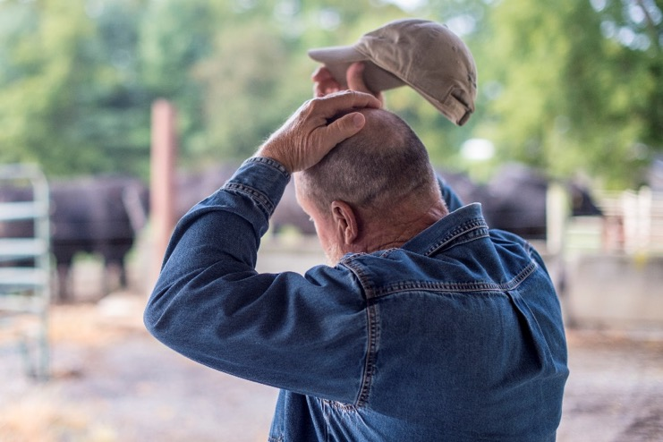
AgrAbility “Disability” Defined
The inability or restricted ability to perform actions, tasks, and activities in the individual’s socio-cultural context and physical environment related to:
self-care
home management
work (job, school, play)
community
leisure roles

Slide 8
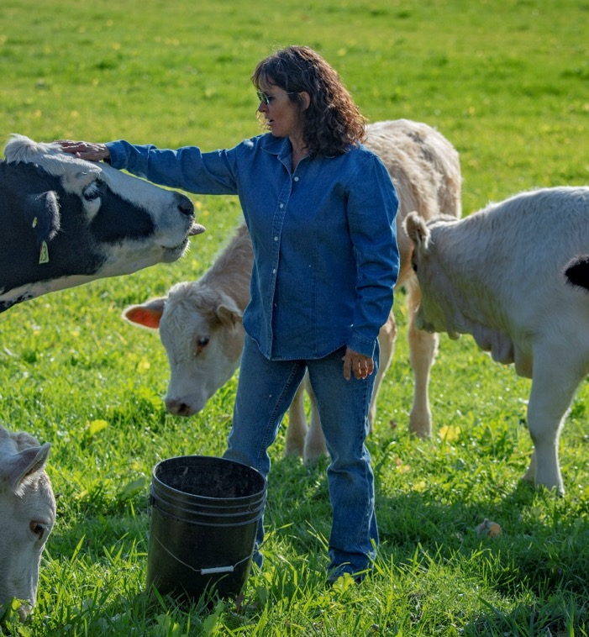
AgrAbility Project Eligibility
Individuals must meet these requirements:
Currently farming or wanting to farm
Have a disability
Need accommodations to work or maintain participation in farm/ranch life

Slide 9
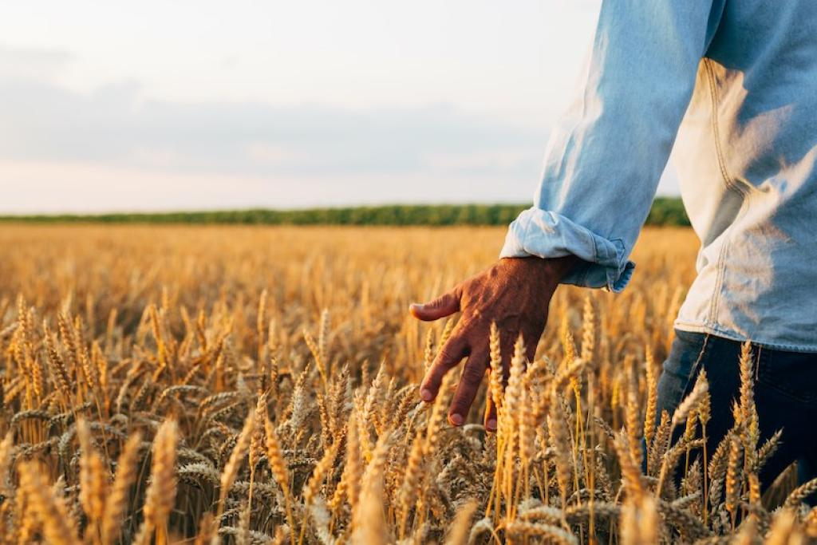
AgrAbility “Farming” Defined
Cultivating, operating, or managing a farm for profit
Farms can include:
  raising stock for food or fiber
  dairy
  poultry
  fish
  fruit
  produce
  orchards
  providing range or pasturage
  growing and harvesting forages
  crops
  grains
  ag-horticultural products (tree nuts, ornamental plants)

Slide 10
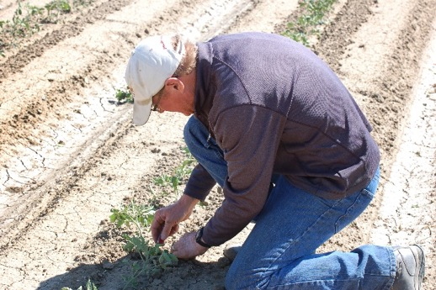
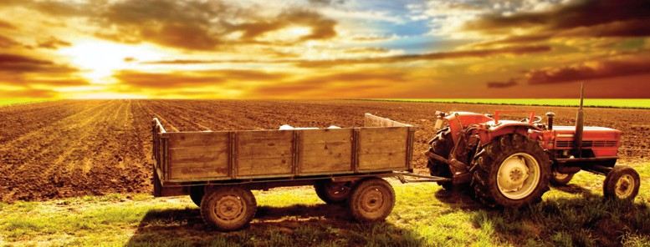
AgrAbility “Farmers” Defined
Those who are actively engaging in farming, deriving income from such activities, or retired from farming
Income minimum set at $1,000/yearly

Slide 11
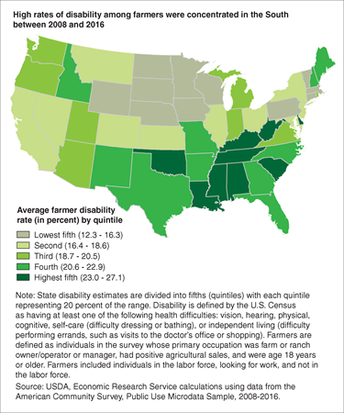
Disabilities in the U.S. Farm population (2008-2016)
Estimates:
19% of US farmers (395,000 people) and 9% of US farmworkers (134,000 people)
New Mexico 4th highest quintile estimated between between 20.6% – 22.9% farmer disability
Based on Census data: individuals identifying as having difficulty with any of these six health issues: vision, hearing, physical, cognitive, self care, and independent living.
Source: Miller and Aherin. 2018. Journal of Agricultural Safety and Health, https://doi.org/10.13031/jash.12934

Slide 12

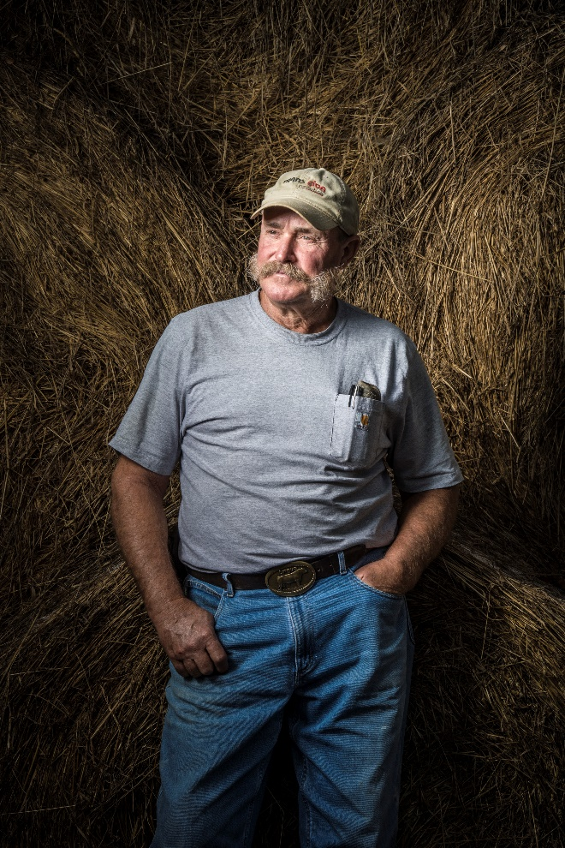
New Mexico Statistics
Estimates:
26% of producers may have a disability
Roughly 17,000 farmers/ranchers may need assistance related to their disability challenges
Notes:
Q: Are there statistics available to provide the number of NM Indigenous Peoples who report as disabled?

Slide 13





Initial funding:
Sept. 2018 – Aug. 2022
New funding:
Sept. 2022 – Aug. 2026
NMAP Partners

Slide 14
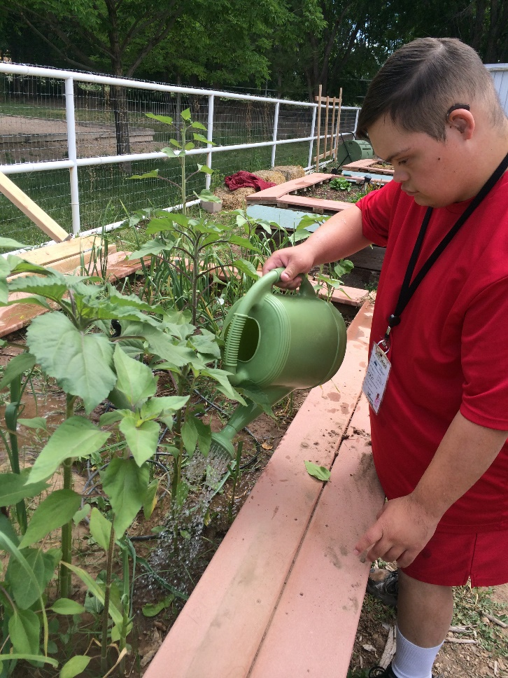
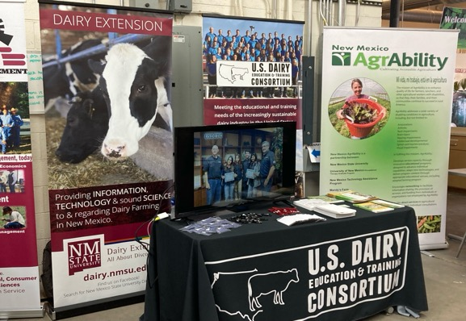
As a land-grant university Extension program,
AgrAbility’s primary task is disseminating evidence-based information to the public
Cultivating Accessible Agriculture
Services
Information and Referral
On-Site Technical Assistance
Education
Training
Peer Support
Accommodations

Slide 15
1. Information and Referral
“Identify” farmers with disabilities or follow up on referrals
Help direct individuals to appropriate resources
Establish communication networks between agencies and organizations
Promote and raise awareness of NMAP
  Community outreach
  Social Media
  Referral Phone and Email
  NMAP Bi-Annual Newsletter (Spring/Fall)
  Web site https://agrability.nmsu.edu/

Slide 16
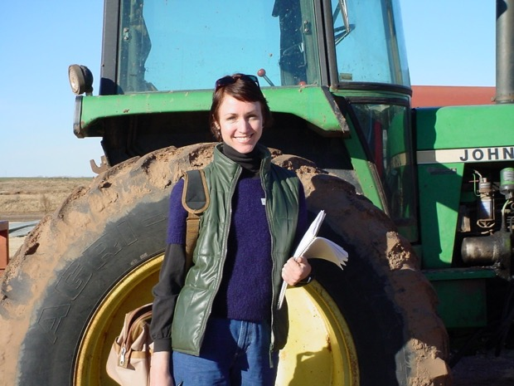
2. On-Site Technical Assistance
Occupational Therapists
Assessments
NMTAP works with Occupational Therapist to complete on-site farm visits to assist in identifying strategies to assist farmers and ranchers with disabilities to participate in home and work life
Adapting and using farm equipment and tools
Modifying farm operations and buildings
Providing strategies to improve farm Quality of Life
Notes:
NMTAP works with Occupational Therapists to complete on-site farm visits to assist in identifying strategies to assist farmers and ranchers with disabilities participate in home and work life

Slide 17
NM Technology Assistance Program
(NMTAP)
A statewide program designed to increase knowledge of, access to, and acquisition of assistive or adaptive technology for anyone with any disability, anywhere in the state, of any age
Device Demonstrations
Device Loans
ReUsed Equipment
Financial Loans
Training for Groups
Information and Assistance http://www.tap.gcd.nm.gov/
Technical Assistance
Notes:
Strategies may include ideas about products, environmental modifications, equipment, and technologies to support performing valued tasks.

Slide 18
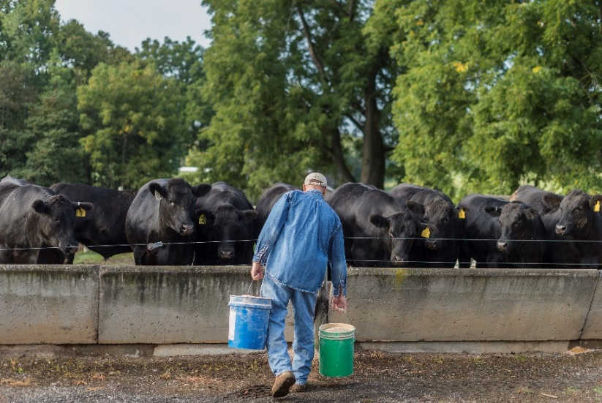

3. Education
Provide agriculture-based education to help prevent further causes of injury and/or disability through
  Workshops
  Webinars
  Displays
  Printed materials
Notes:
NMAP Apprenticeship program: UNM Occupational Therapy students provide individualized supports for the food growers and their businesses.
NMSU Extension has specialists in ag-related fields for educational program delivery, and there are Extension county-based agents who can provide direct access.

Slide 19
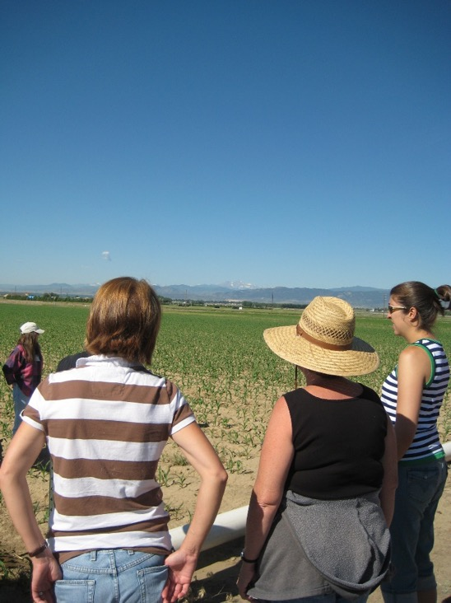
4. Training
Assist Cooperative Extension educators/ agents and other rural professionals with upgrading their skills in assisting farmers with disabilities
Prepare OT professionals to provide services to people with disabilities working in agriculture
NMTAP provides trainings on Assistive Technology for farmers with disabilities

Slide 20

5. Peer Support
Develop and coordinate peer support networks
  Locate volunteers
  Offer referrals to specific support groups
  Host and/or assist in forums
  Develop and distribute a resource guide

Slide 21

6. Accommodations
Professional advice
  Modifications to the work environment
  Address accessibility issues
  Job re-structuring
  Modified work schedules
  Modified equipment
  Assistive technologies / Adaptive devices
  Adapted farming education

Slide 22
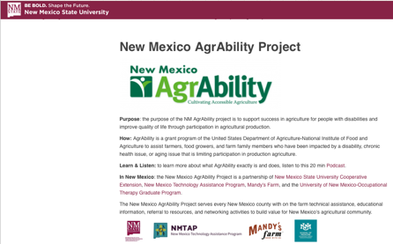
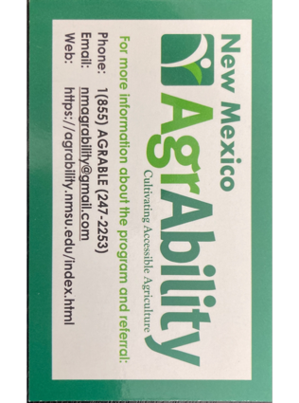
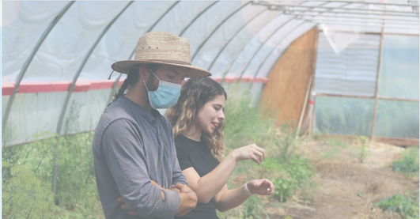
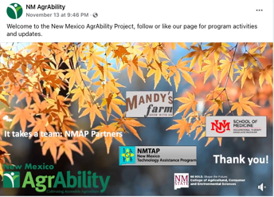
Information and Referral
Website: https://agrability.nmsu.edu
Referral Phone:
1(855) AGRABLE (247-2253)
Email:
nmagrability@Gmail.com
Newsletters: Spring & Fall
Social Media - FB: https://www.facebook.com/NMAgrAbility

Slide 23
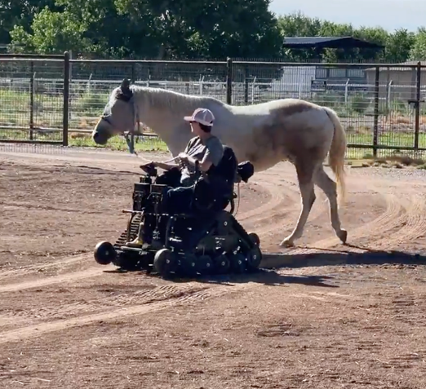
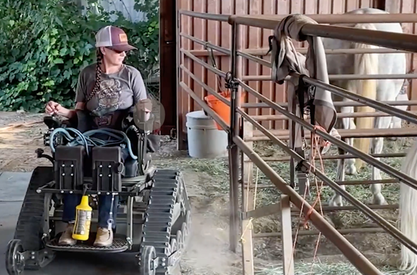
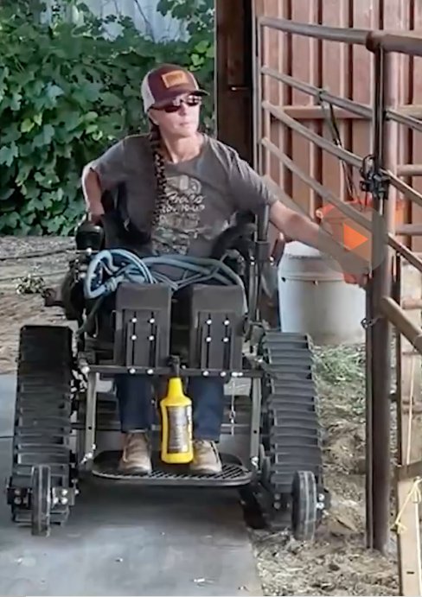
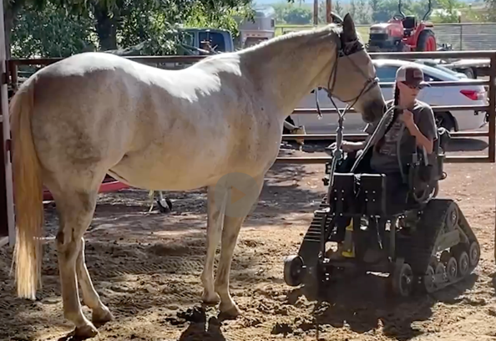
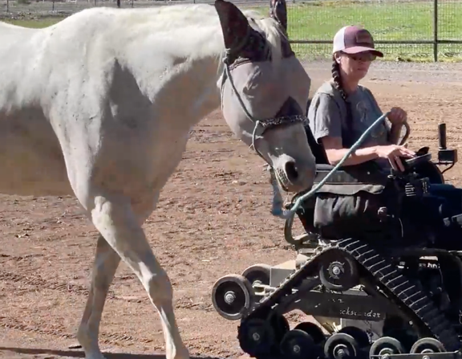

Slide 24

Regional AgrAbility 2-day Workshop
September 27-28, 2022:
NMAP collaborated with the National AgrAbility Project and the 1994 land-grant, Southwestern Indian Polytechnic Institute (SIPI), to host a regional AgrAbility workshop, at SIPI’s campus in Albuquerque.
The free two-day event provided presentations on how existing, new, and prospective tribal farmers and ranchers and others with disabilities and other functional limitations can remain or become successful in small-scale farming and gardening.
With 69 workshop participants representing five states, including NM, IN, TX, CO and WA, attendees had the chance to join presentations from 16 individuals from at least 29 different agencies.
Workshop topics included physical rehabilitation issues of farmers and ranchers; microscale farming; adaptive tools and technology; worksite assessment; and farmer stress and suicide prevention.

Slide 25
Mandy’s Farm
Adaptive Farming:
NMAP Apprenticeship Program
10 apprenticeships/year
2-year commitment
On-site programs teach farming techniques and use of adaptive tools
Plan and implement individual small farm businesses
Volunteers in community farm workshops and mentorships
Source: Mandy’s Farm https://www.mandysfarm.org
Notes:
This year the curriculum created by Mandy’s Farm is being developed with assistance from the NMSU Global Campus for online delivery and will include certification for participating OTs.

Slide 26
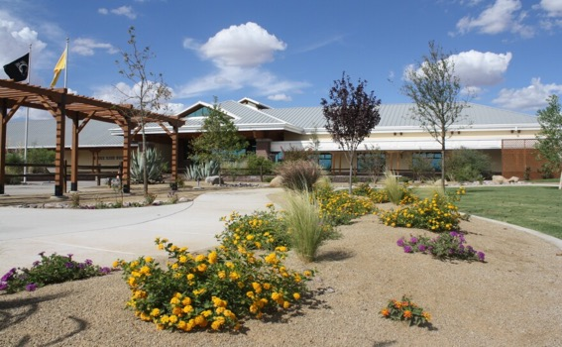
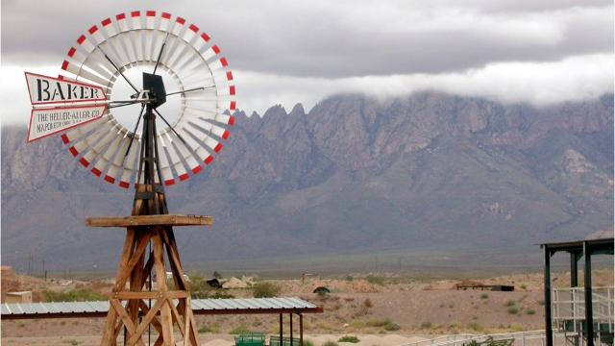
Future Projects in the Making…
Collaborate with VA VR&E - Veteran Readiness & Employment - to accommodate veterans: potentially do assessments for veterans
Finish writing and submitting AgVets Grant to obtain funding to adopt and implement Battle Ground to Breaking Ground veteran training program to New Mexico
NMAP is planning a “Day on the Farm” event to train its Division of Vocational Rehabilitation team members in the ways that people with disabilities will and can continue to be functional food growers.
Continue developing with NM Farm & Ranch Heritage Museum in Las Cruces an exhibit on AgrAbility (both the National and NMAP), to include an adaptive garden (opening spring 2025)
Bring the 2025 AgrAbility National Training Workshop to Las Cruces at the opening of the Agrability exhibit at the NM Farm & Ranch Museum (March 2025)
Updated Reporting Tool to capture all AgrAbility activities across all partners

Slide 27

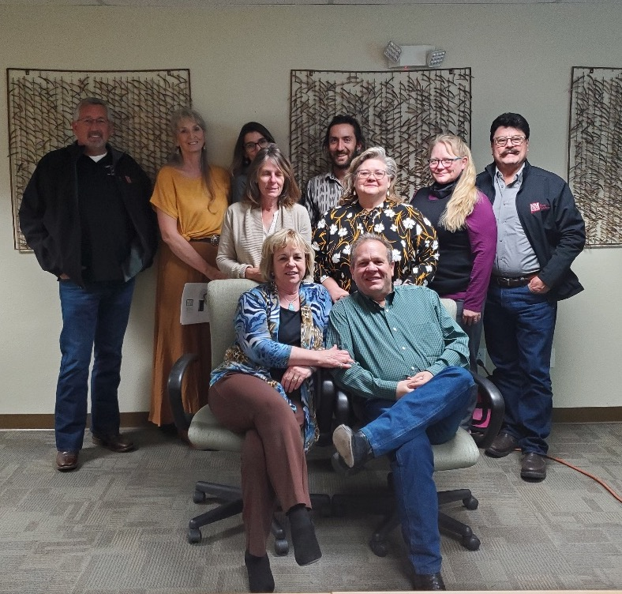
Our team stands ready to help!
Contact Us
PHONE: 1(855) AGRABLE (247-2253)
EMAIL: nmagribility@gmail.com
Web: http://agrability.nmsu.edu/index.html
Robert Hagevoort
dairydoc@nmsu.edu
(806)786-3421

Slide 28





It takes a team: NMAP Partners
Thank you!

Slide 29
Thank You!
What ways do you see our programs working together?

