Slide 1
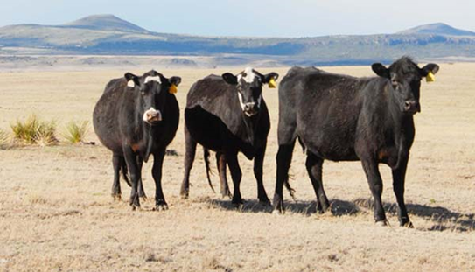
Considerations when Preparing for and Managing Drought on the Ranch
June 27, 2023
Cody Knutson, Drought Planning Coordinator

Slide 2
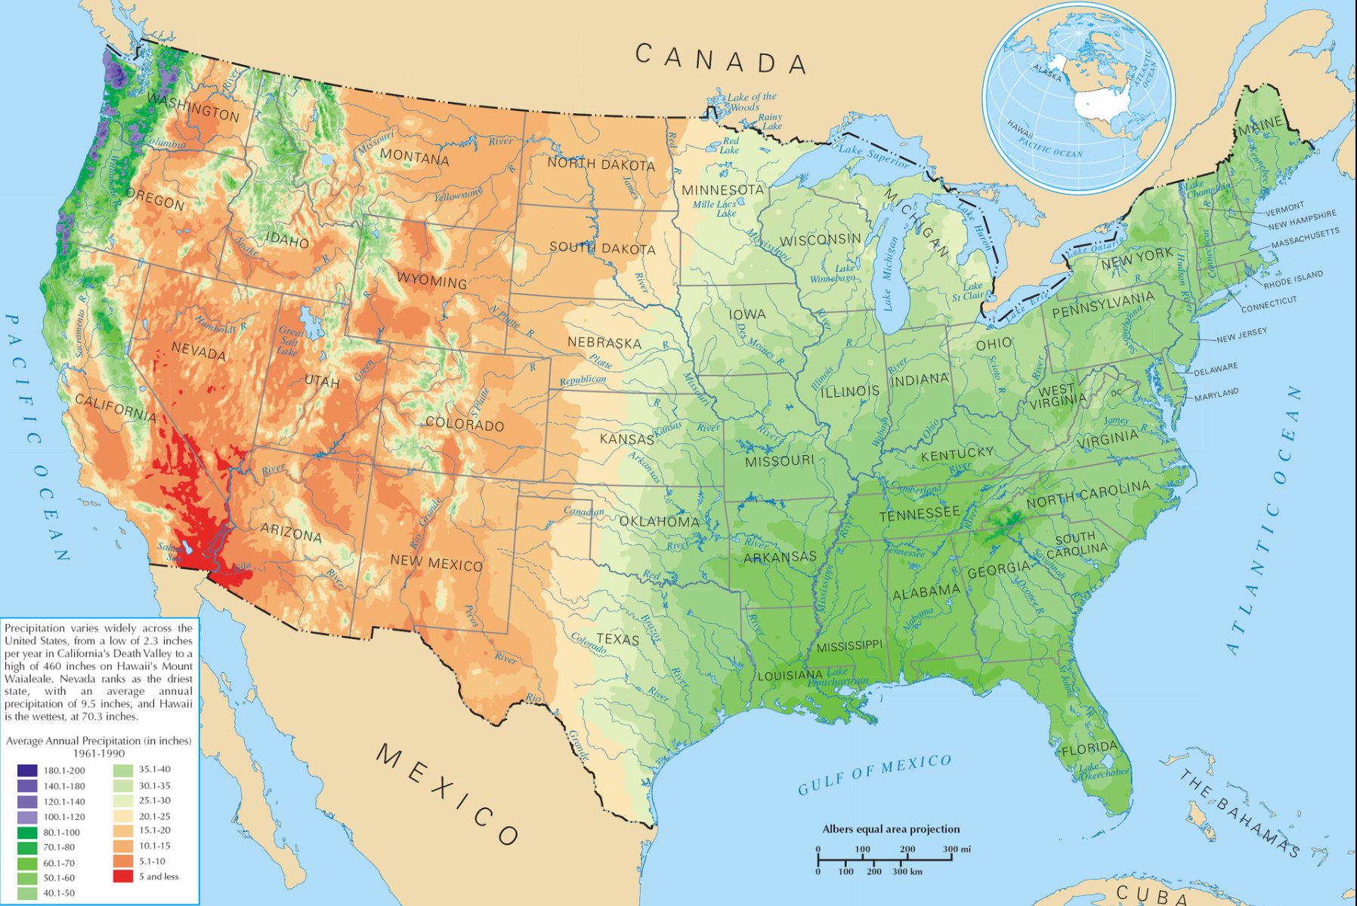
Average Annual Precipitation
Notes:
When discussing climate, you will often see maps of average annual or monthly precipitation

Slide 3
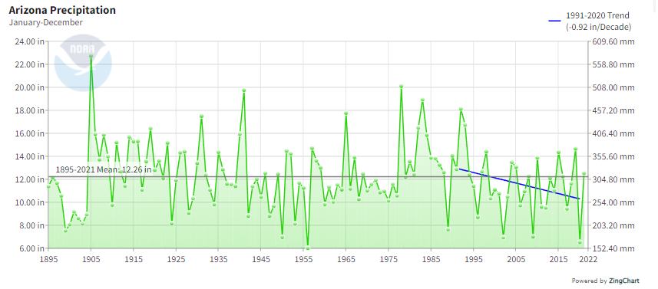
How to deal with uncertainty?
Notes:
However our climate is much more variable. It’s difficult to find an average year

Slide 4
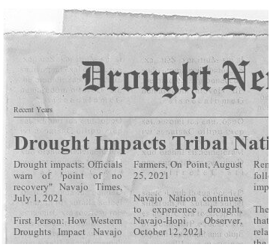
Notes:
And, how do you deal with the impacts of variable weather and climate?

Slide 5
Mission: To lessen societal vulnerability to drought by promoting planning and the adoption of appropriate risk management techniques.
http://drought.unl.edu
Notes:
Our perspective on drought management is reflected in our mission

Slide 6
Crisis Management Approach

Slide 7
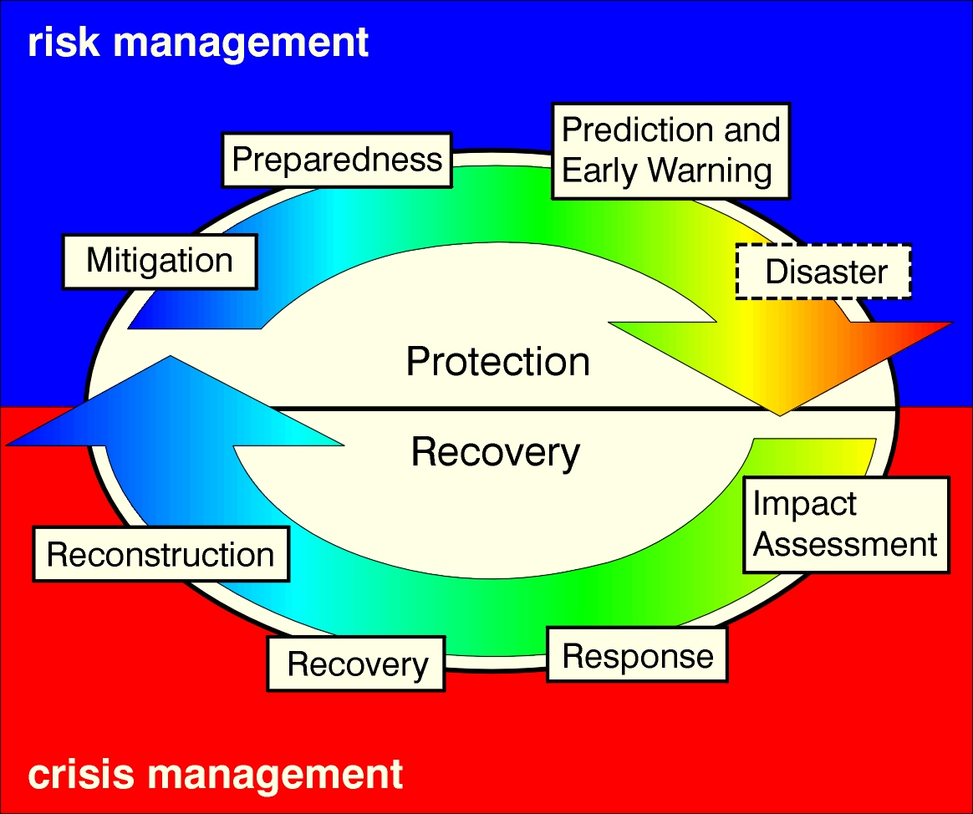
Crisis management replaced by risk management
Hazard Event

Slide 8
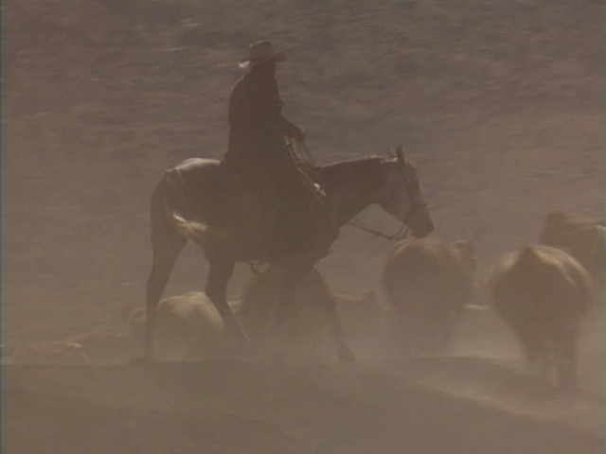
Drought Risk Management on the Ranch
“Here’s what my dad used to tell me. He said, if you bet on dry weather in this country, you’ll be right more than half the time”
(Nebraska Rancher 2005)
Notes:
I’ll now talk about our efforts working with ranchers and advisors to promote drought risk management

Slide 9
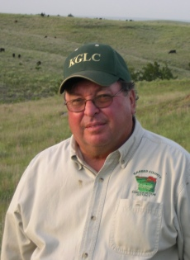
Ted Alexander
Rancher in south-central Kansas
Working with NRCS and university
researchers to improve ranch
management over the last 30+ years
Including development of long- and short
term drought plans
Long-term: make ranch resilient to drought (prescribed
burning, rotational grazing, water distribution, custom grazing)
Short-term: identifying critical condition, dates and actions
Notes:
First started working with ranchers on drought planning when Ted Alexander contacted a colleague of mine to review a drought plan he had put together for his operation in 2000.

Slide 10
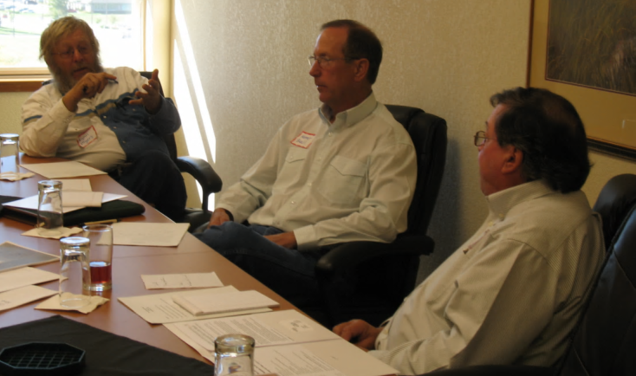
Led to:
Several activities to better understand and promote drought planning among livestock producers
Lincoln Drought Planning Workshop (November 2009)
Creation of the Managing Drought Risk on the Ranch website and planning guide (2012)
Outreach: workshops, webinars, and mentoring network
workshops in Kansas, Nebraska, Colorado, Wyoming, New Mexico, South Dakota, Oklahoma, and Texas
Webinars across the Great Plains
Growing network of ranchers and advisors
Continued studies and tool development: rancher surveys, Grass-Cast forage forecast tool, example drought plans, tribal rancher perspectives
Notes:
Worked with ranchers and advisors from across the Great Plains to develop the Managing Drought Risk on the Ranch website and planning guide (next slide)

Slide 11
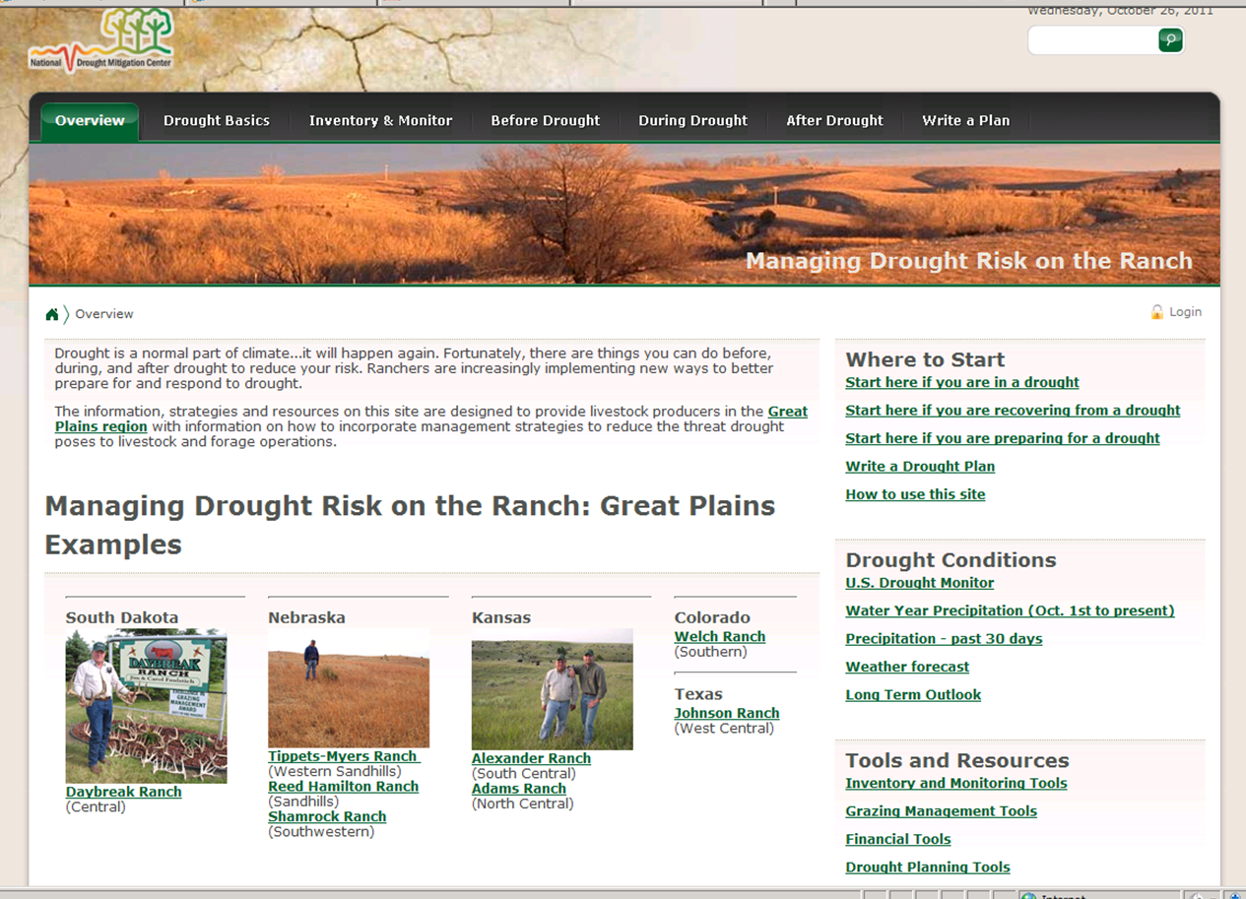
http://drought.unl.edu/ranchplan
Notes:
Talk about each of the tabs at the top and point out case studies of ranchers who have developed drought plans

Slide 12
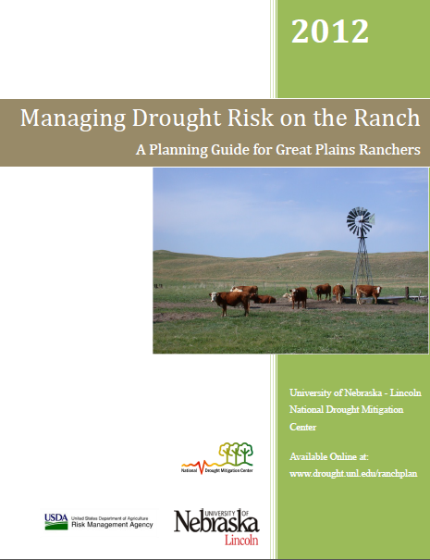
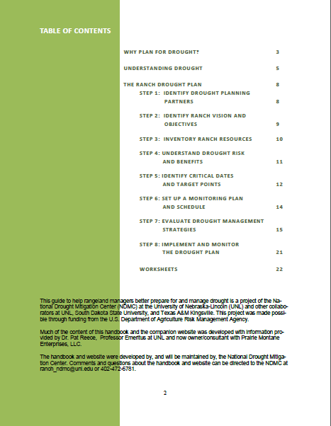
http://drought.unl.edu/ranchplan
Notes:
Step by step drought planning process – will briefly describe each step in the following slides

Slide 13
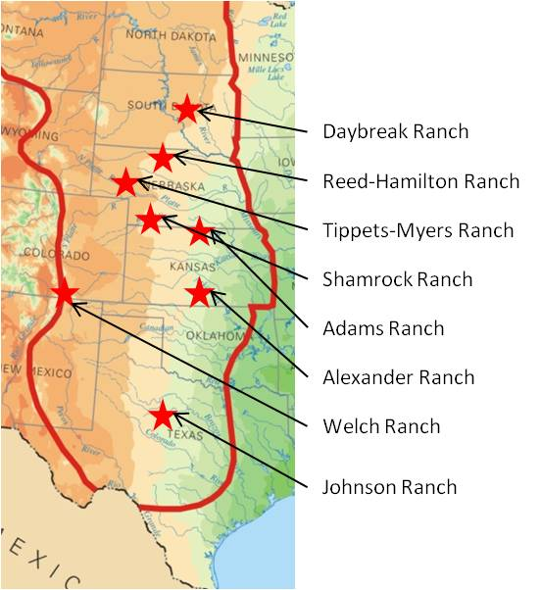
Put together a drought planning team
Family and friends
Technical advisors and consultants
Insurance agents
Bankers
Planning partners can help develop a ranch vision, understand the effects of drought, and identify the most appropriate strategies
Done early in the process to make sure everyone’s on the same page
“If you have a plan, even if it’s in your head, you need to share it with the people that work with you. Whether it’s your children, your banker, or your employees… it needs to be shared information.” (Texas rancher)

Slide 14
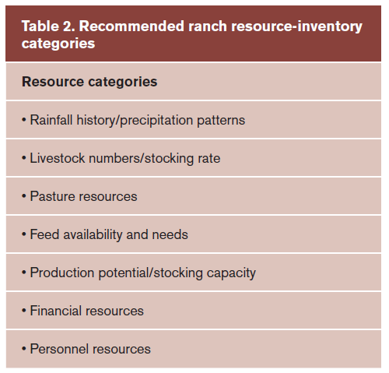
Conduct Inventory of Ranch Resources
Provides baseline of what you have to work with
Can work with advisors; NRCS whole-ranch inventory
Notes:
This is a list of resources to inventory developed by our group of ranchers and advisors – often bring in experts/consultants to help them do the inventory

Slide 15
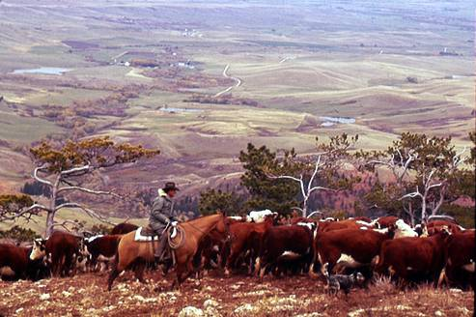
Understand Drought Risks and Benefits
How it affects your operation
Effects of Drought in Nebraska
Cattle culling and reduced stocking rates
Reduced grass/hay production
Surface water/ground water quantity and quality problems
Increased supplemental feed costs
Crop losses
Emotional stress
Increased pests such as grasshoppers
Wind erosion
Increased irrigation
Reduced cattle pregnancy rates
Increased weed pressures
Tree losses
Hindered pasture burns
Increased disease
Are there any benefits to drought?
Notes:
Need to understand drought and how it impacts your operation. These are the results of a survey of Nebraska ranchers. A wide range of potential impacts are noted. What impacts are the most relevant for your operation – which are most pressing to address.

Slide 16
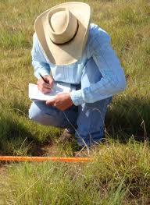
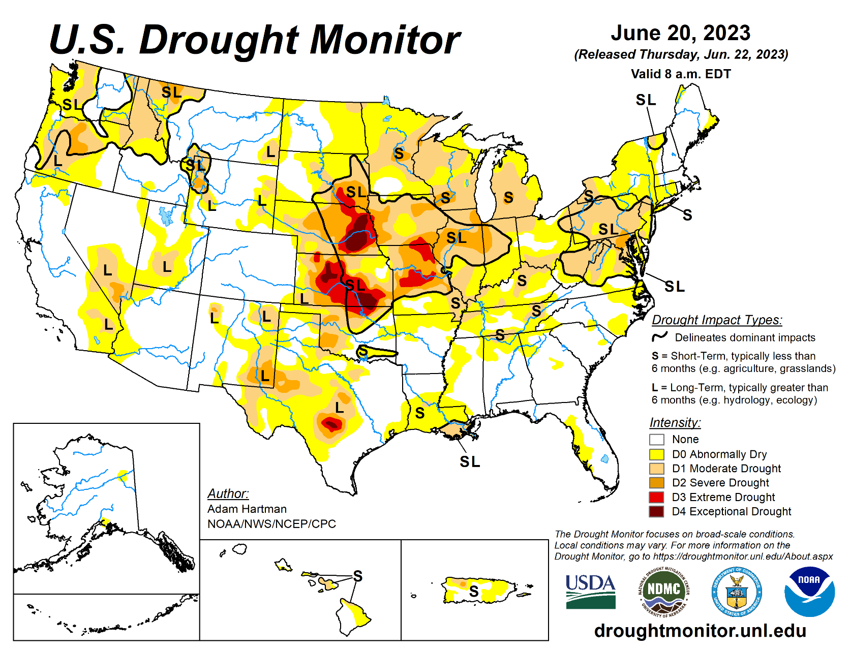
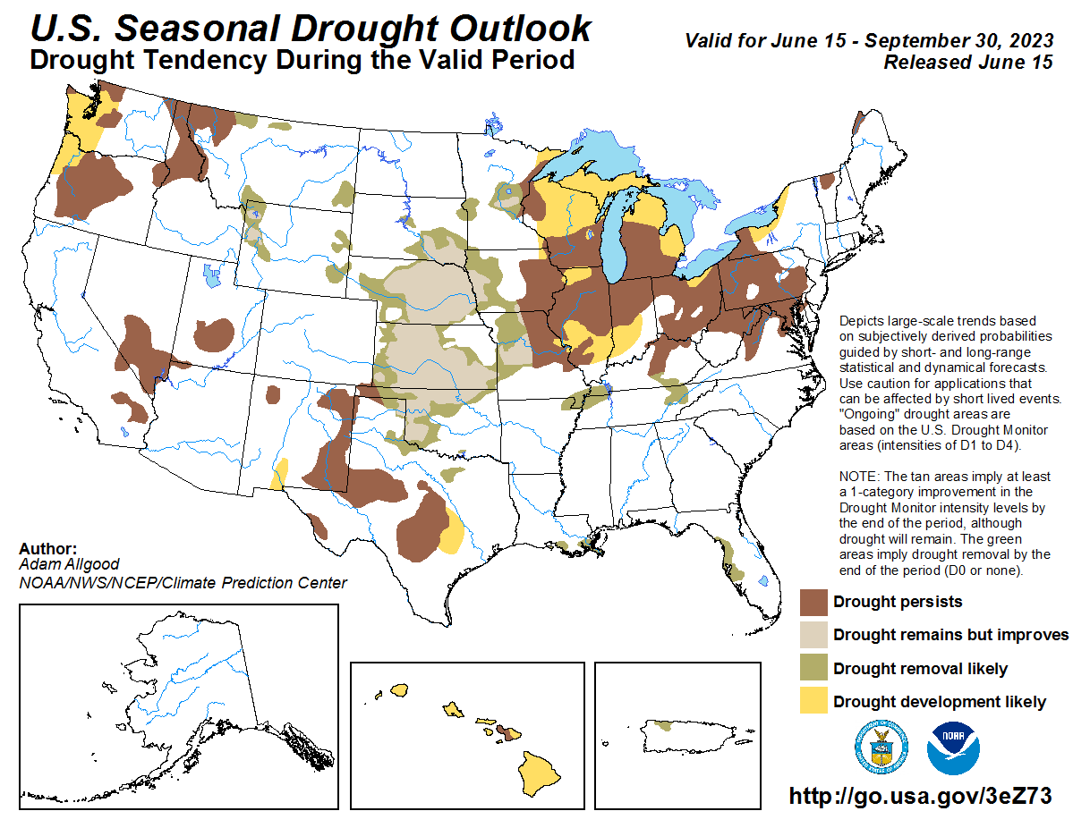
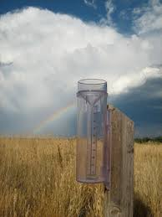
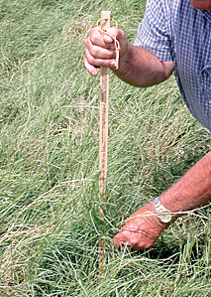
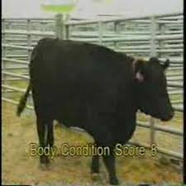
Develop a Monitoring System
“You can’t manage it, if you don’t measure it”
On your ranch: determine what to monitor on an ongoing basis
Notes:
In order to manage for drought, you need to be able to monitor conditions on an ongoing basis. Helps you understand when you’re going into drought and when to trigger actions. There are national drought monitoring products and outlooks, but you need to decide what is important and feasible to monitor on your operation (rainfall, forage production, cattle health, etc.) There are also some new tools that enable you to utilize monitoring information to make management decision, such as Grasscast. Having a monitoring system can also help you know when things are good on your operation – maybe you will want to increase your herd size, for example, when you have good grass and precipitation (and more in the forecast).

Slide 17
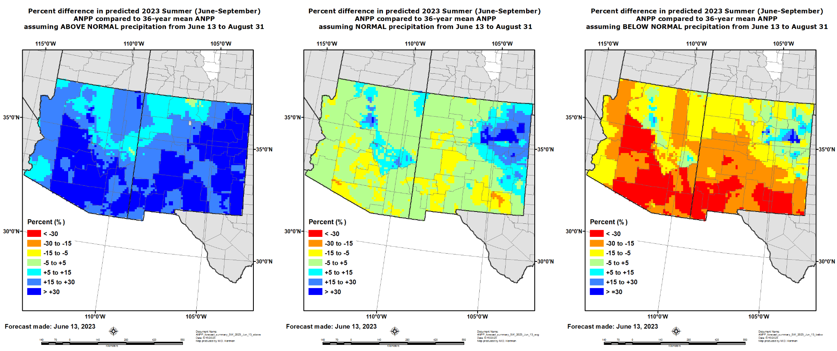
Grass-cast Productivity Forecasts
Above normal, near normal or below normal, grass productivity in the upcoming growing season?
Colorado State University, U.S. Department of Agriculture (USDA), National Drought Mitigation Center, and the University of Arizona
https://grasscast.unl.edu/

Slide 18
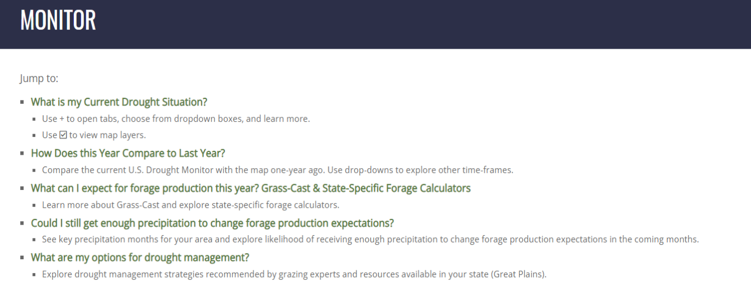
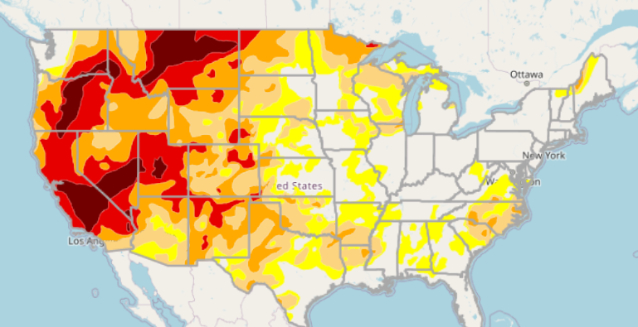
Answers to Rancher’s Questions
https://drought.unl.edu/ranchplan

Slide 19
Identify Critical Dates for Making Decisions
Monitoring ranch resources and thinking through decisions that must be made throughout the year, can help identify critical decision dates and criteria for making them.
Based on:
Historical rainfall
Forage growth
Insurance sign-ups
Grazing contracts
Notes:
Ranchers will tell you that one of the most difficult decisions when managing drought is when to make decision. Thinking through when you need to make important decision throughout the year will help you identify critical decision making dates for your operation. You can then use your monitoring system to assess conditions at those times to help you make the decision. This is an example of a Kansas rancher’s drought plan showing his critical dates, monitoring information he assessed at those dates, and management decision he plans to make. The dates and decision will probably be different for your operation.

Slide 20
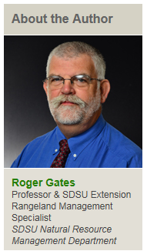
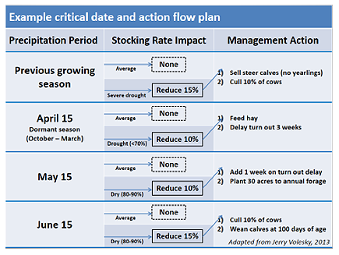
Northern Plains Critical Dates for Livestock Production
Roger Gates (2013) Developing Trigger Dates for Drought Contingencies, SDSU iGrow

Slide 21
Identify Strategies to be Implemented Before, During, and After Drought
Pre-Drought Actions Shape Choices
Maximize health of resources
Build diversity and flexibility into operation
Ex) rotational grazing, water development, forage selection, finances (reserves, alternative income), insurance
During Drought
Adjustments to protect resources and maintain viability
Ex) reduce stocking rate, supplemental feeding, temporary off-ranch income
After Drought
Actions to enhance drought recovery
Delayed restocking; tax considerations
Notes:
As shown in the previous example, you need to identify actions to be implemented in your plan that are tailored for your operation not only during drought but before drought, as well. Implementing best management practices before drought will put you in a better situation going into drought and will likely decrease the need to make as many adjustments during drought. Nonetheless, some adjustments will likely be necessary and they should be thought out ahead of time. Some ranchers like to have a definite plan of what they’re going to do, while others and advisors may say to have a few options outlined and weigh your options when you reach a critical decision making date.

Slide 22
Combine elements into a plan
pre-drought strategies
critical dates
decision criteria
actions
Write it down!
“I think it’s real important to have that discipline, and writing it out is probably as good a way as any to get that discipline.”
Notes:
With all of this information, put it together into a plan that includes pre-drought best management strategies, along with critical dates, decision criteria to be evaluate near those dates, and strategies to be implemented as the drought worsens or improves.

Slide 23
Why Plan for Drought?
Drought is a normal part of climate
We can’t control whether or not it rains
We can control what we do before, during and after drought to limit losses

Slide 24
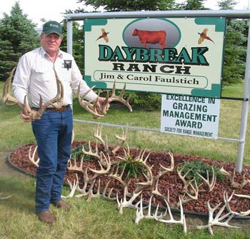
Jim Faulstich – Why Plan for Drought
Highmore, SD
Operation
Cow-calf; commercial grazing for bred yearling heifers
Hunting operation
No-till farm
Maintain profit and keep our next generation on the land and in the community
“We need to be sustainable… we need to be in business when the drought is over.”
Maintain quality of life
“Think of the amount of stress drought puts people through. A drought plan can do huge things … so you can deal with it. We just follow our plan on a routine basis now.”
Notes:
Testimonies from ranchers on why having a drought plan is important.

Slide 25
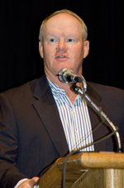
John Maddux
Wauneta, Nebraska
Operations
Cow-calf, yearling, and cattle-feeding enterprises
“Hope is not a plan”
“Drought planning is putting you in a mindset to be proactive – to get ahead of the problem.
“It helps make sure you are in charge of decisions – the drought in not making decisions for you.”
“Having a written drought plan takes the moment-by-moment emotion out of the picture.”
Notes:
Last quote – trying to deal with a drought while you’re in the midst of it is stressful and often emotional (hate to sell those cows). Having a plan helps take some of the emotion out of it knowing thought about the decisions you need to make and are doing what’s best for your operation.

Slide 26
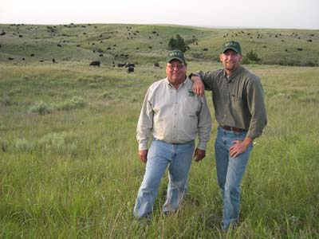
Ted Alexander
Sun City, Kansas
Operation
Seasonal custom grazing with cows and calves, no haying, no tractor
“I’ve used my drought plan several times, and once for wildfire…”
“Fire burned 50% of my ranch. Yearlings were set to arrive a couple days later. When the fire happened, I applied the drought plan and went along… I had the infrastructure [fencing, water, etc.] and plans in place to accommodate the loss of grass.”
Notes:
Having a drought plan can also help in any situation where you lose grass…

Slide 27
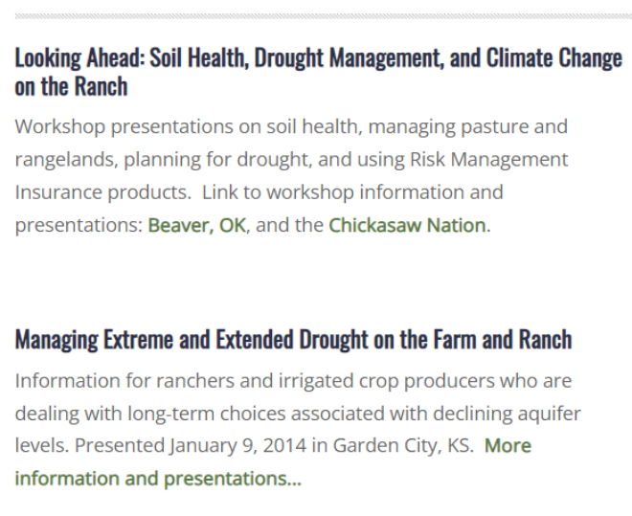
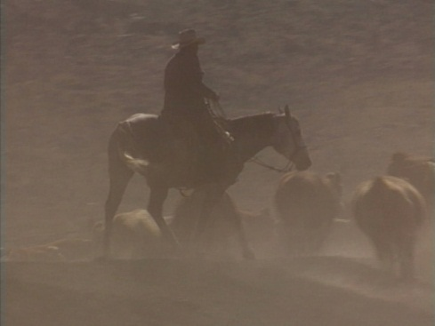
Training Materials
https://drought.unl.edu/ranchplan

Slide 28
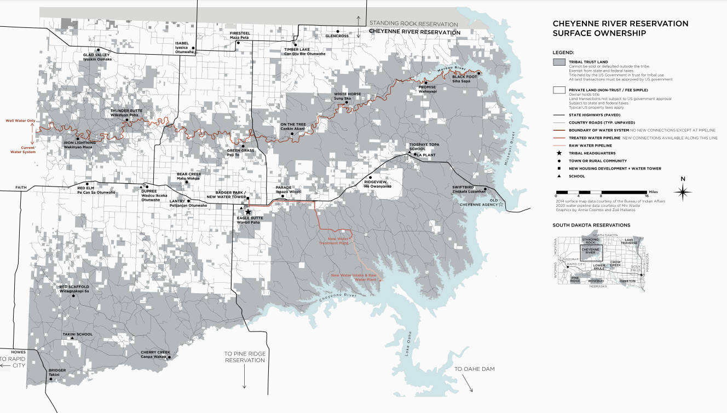
South Dakota Tribal Land Tenure and Drought Management on the Ranch
New Project
National Drought Mitigation Center
Natural Resources Conservation Service
Understand and tailor guidance for tribal ranchers working with:
Trust lands
Fractionation
Bison
More to come…
Let me know if you have information or example drought plans to contribute!

Slide 29
Cody Knutson
cknutson1@unl.edu
(402)472-6718
http://www.drought.unl.edu/ranchplan

