Slide 1
WINTERIZING THE GARDEN and FALL PLANTING
WITH BUD LOPEZ
TRIBAL AGRICULTURE EXTENTION AGENT
McKinley COUNTY
budl2@nmsu.edu
505-863-3432

Slide 2
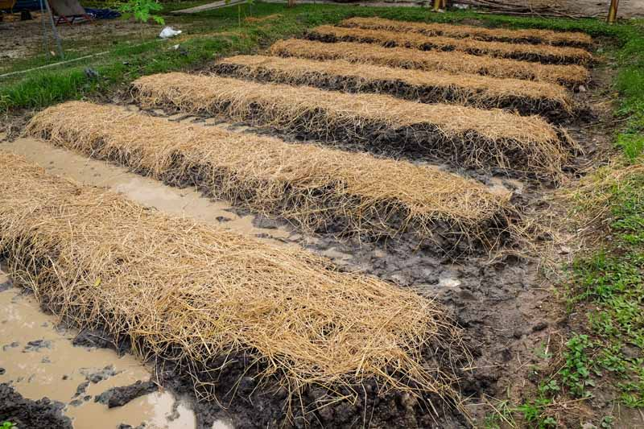
WHY WINTERIZE
The main goal is to protect your soil from the harsh conditions it must endure in the winter.
Replenish nutrients needed for next season.

Slide 3
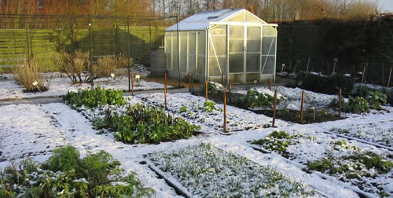
WINTERIZING
Annual plant removal
Weeding
Soil amendments
Mulching
Securing Mulch
Irrigation and tools

Slide 4
ANNUAL & VEGETABLE REMOVAL
In your annual and vegetable garden remove dead and dying annual plants.
In some cases, you can leave the roots, this can help decrease erosion and as they decompose, they will return nutrients to the soil.
Dispose of the material by bagging in black plastic.
This will help to remove much of the disease and unwanted seed, decreasing the chance of infecting next years crop, especially with mildews and overwintering pests.
Notes:
Remove crop remains that may have had disease
If the roots aren’t too thick or woody they can contribute to the soil next season, Kind of a built-in compost.

Slide 5
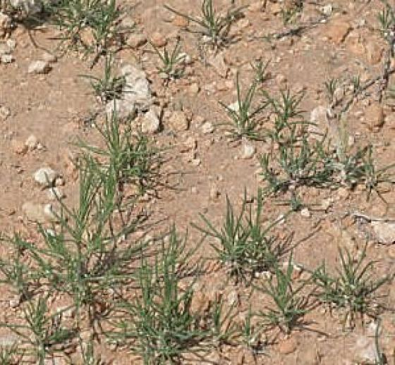
WEEDING P.O.O.P (PLANTS OUT OF PLACE)
Ideally the weeds are removed as they came up or at least before they go to seed.
Remove the whole weed, including the root if possible.
Many of our most common weeds are perennial and can come back from the root.
Common perennial weeds include Bindweed, burdock. Dandelion dock plantain, thistle and ragweed. Many weed grasses also.
It is paramount to remove the seed heads, even if they have ripened and opened. There are always straggler seed hanging on that can be deposited.
Contain and dispose.
httpControlling Annual vs. Perennial Weeds (thespruce.com)s://www.thespruce.com/ is a good article on annual vs. perennial weed control.

Slide 6
ADD SOIL AMMENDMENT
It is always a good idea to know the make up of your soil. Testing by a reputable lab is always a plus.
In our area, most soils are low in organic matter. Adding organic matter like compost will improve almost all soils. It will increase the water holding capacity of sandy soils and improve nutrient content. It will also improve drainage in clay soils.
In very poor soils you will want add two to three inches to the surface.
Till or No-Till is your next question.

Slide 7
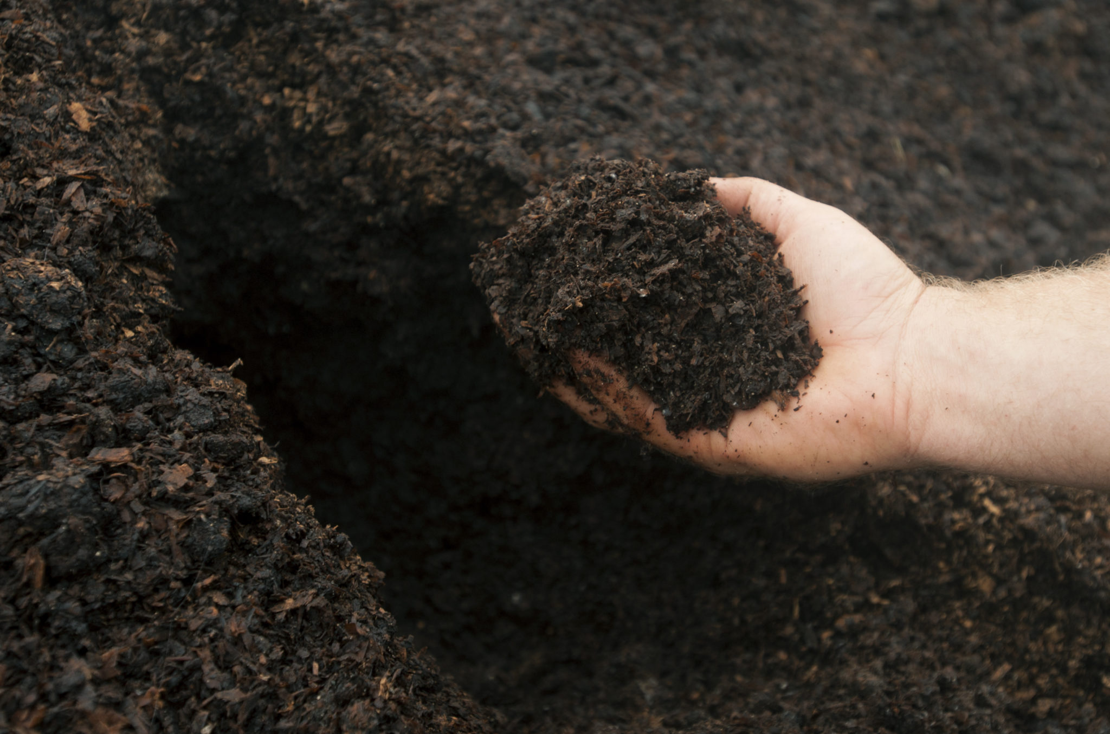
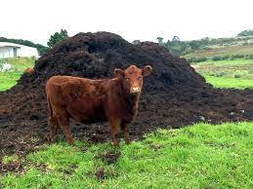
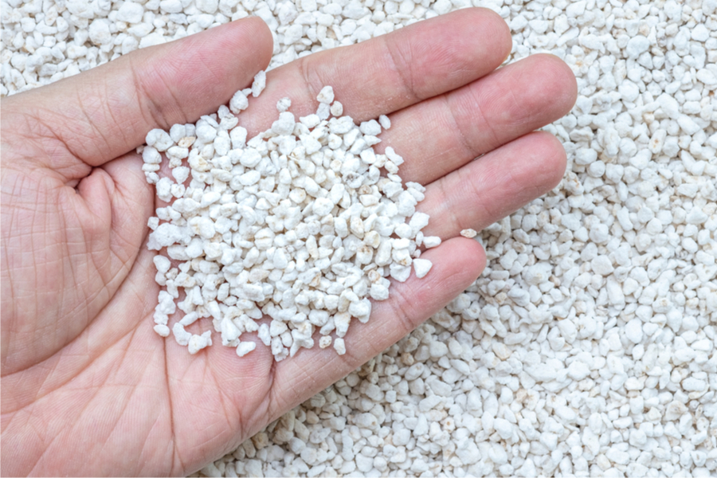
SOIL AMMENDMENTS
Soil amendment is any substance which is intended to change the chemical or physical characteristics of soil. These include:
Compost:
Plant based
Animal waste based
Mineral based

Slide 8
COMPONENTS OF COMPOST
Plant based amendments can include green waste, leaves and humus. It has available Nitrogen, Phosphorus and Potassium. In addition, it has carbon and many micronutrients.
Animal waste-based amendments can come from, cattle, sheep, chicken and rabbit. They all have a good supply of available NPK and some micronutrients.
Mineral based amendments like Vermiculite and/or Perlite are added to soil to aid in aeration and water retention. This encourages higher microbial activity.
Commercial composts can contain all the above or sold individually.

Slide 9
TILLING/TURNING
Tilling/turning advantages include aeration and loosening of soils. It also helps to incorporate amendments more quickly to a depth where it is needed.
Tilling/turning disadvantages include disruption of soil structure, contributing to erosion, both water and wind. It also redistributes and accelerates decomposition of organic material and makes it unavailable to the microbes which they need to accomplish nutrient cycling. Creates of vicious cycle.

Slide 10
NO-TILL
No-till advantages include lower costs for soil prep, encourages microbial vitality, maintains strong soil structure, combats climate change and eventually increased yields.
No-till disadvantages include the possible increase in chemical use due to the absence of tilling. The learning curve is steep and takes time for the farmer to gain the knowledge and skill to justify its use for satisfactory yields. Some land use can be limited due to types of soil and single use restrictions of the no-till.

Slide 11
MULCHING
Mulch is a layer of material applied to the surface of soil. Reasons for applying mulch include one or all the following.
Conservation of soil moisture.
Improving soil fertility.
Improving soil health.
Aid in weed suppression.
Enhance the visual appeal.

Slide 12
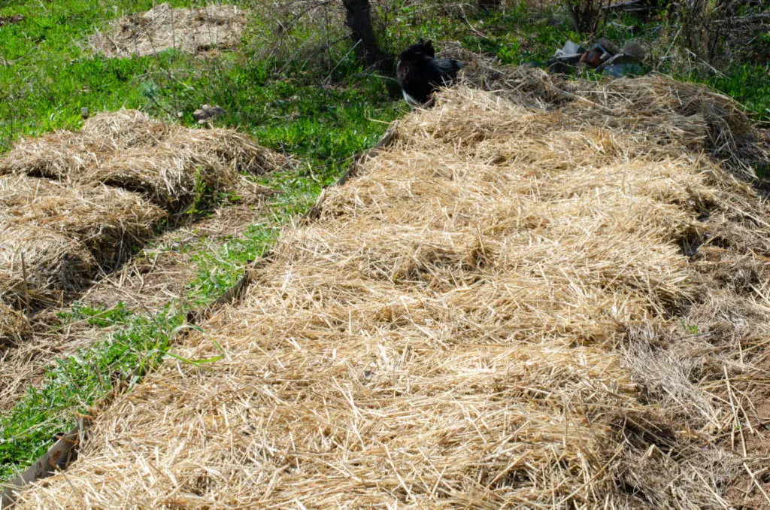
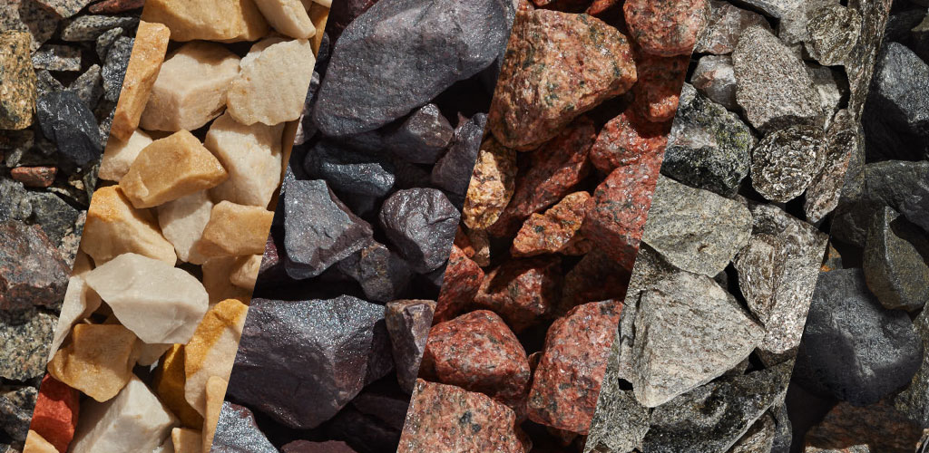
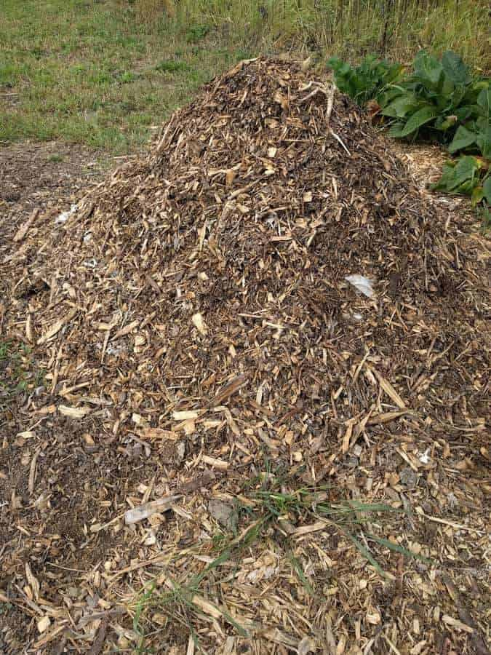
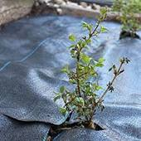
MULCH TYPES
Mulch can include many organic and inorganic materials. Many serve as amendments and stabilizers.
Some examples are:
Organic:
Yard waste
Compost
Hay and Straw
Wood chips
Bark
Synthetic:
Landscape fabric
Stones
Rock/gravel

Slide 13
MULCH STABLIZATION
Stabilize mulch with anything that will prevent wind erosion and yet allow moisture infiltration.
Cardboard
Bird netting
Shade cloth
Old bed sheets
Burlap
Notes:
Us landscape staples, rocks,

Slide 14
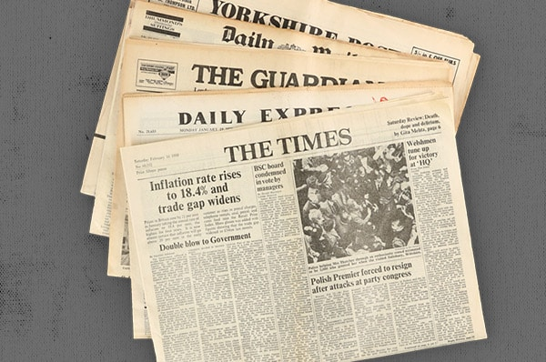
Cardboard/ Newspapers
They can be laid over your mulch to prevent wind from blowing your mulch away.
It breaks down quickly and can be incorporated into you soil as soil texture amendment and carbon source.
it’s cheap, free.

Slide 15
Bird netting
You can stretch bird netting over your mulch.
For coarse mulches It works well to keep it in place.
It can be reused for several seasons.

Slide 16
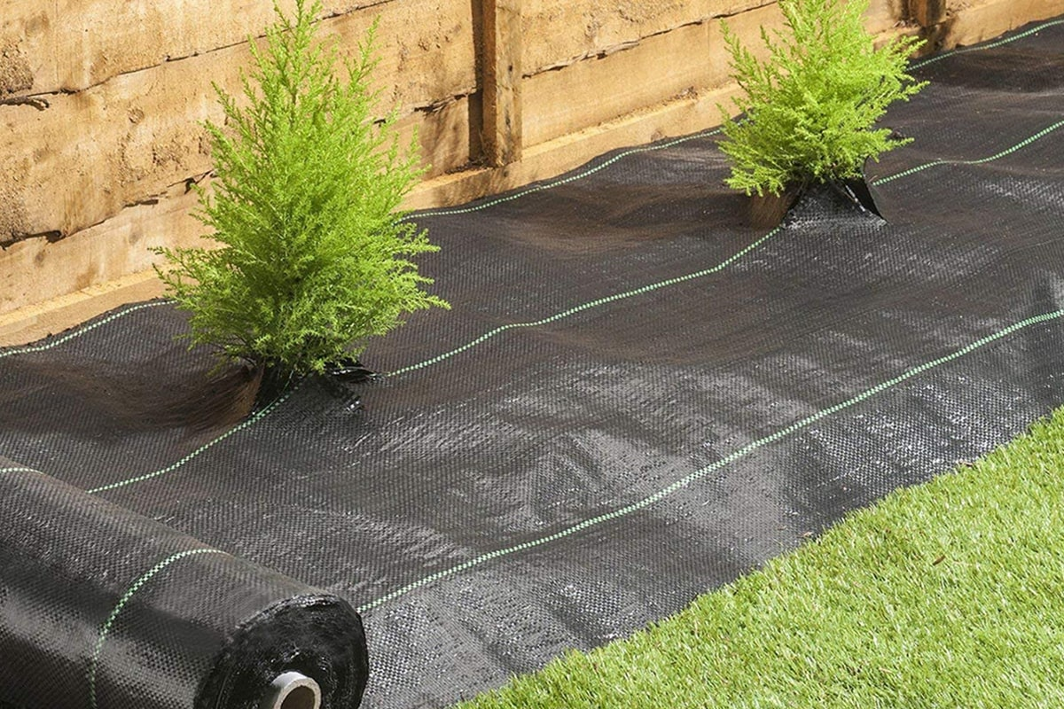
Shade cloth and Weed fabric
Like bird netting it can be used year after year.
I works well if your mulch is fine textured and prone to blow away.
Moisture can penetrate it easily

Slide 17
Old Bedding
Worn, torn sheets work like the others to prevent wind erosion and allows for water infiltration.
For smaller areas they are cheap and can also be reused.

Slide 18
Burlap
Functions the same as the others.
It can be found in rolls, as sacks and sheets.
It also typically lasts more than one season.

Slide 19
Black plastic
Not my choice but it has advantages.
Can aide in weed control of the soil.
Prevents wind erosion.
Easy to work with.
Cheap
Disadvantages.
No water infiltration.
Not biodegradable.
Can cause runoff issues.

Slide 20
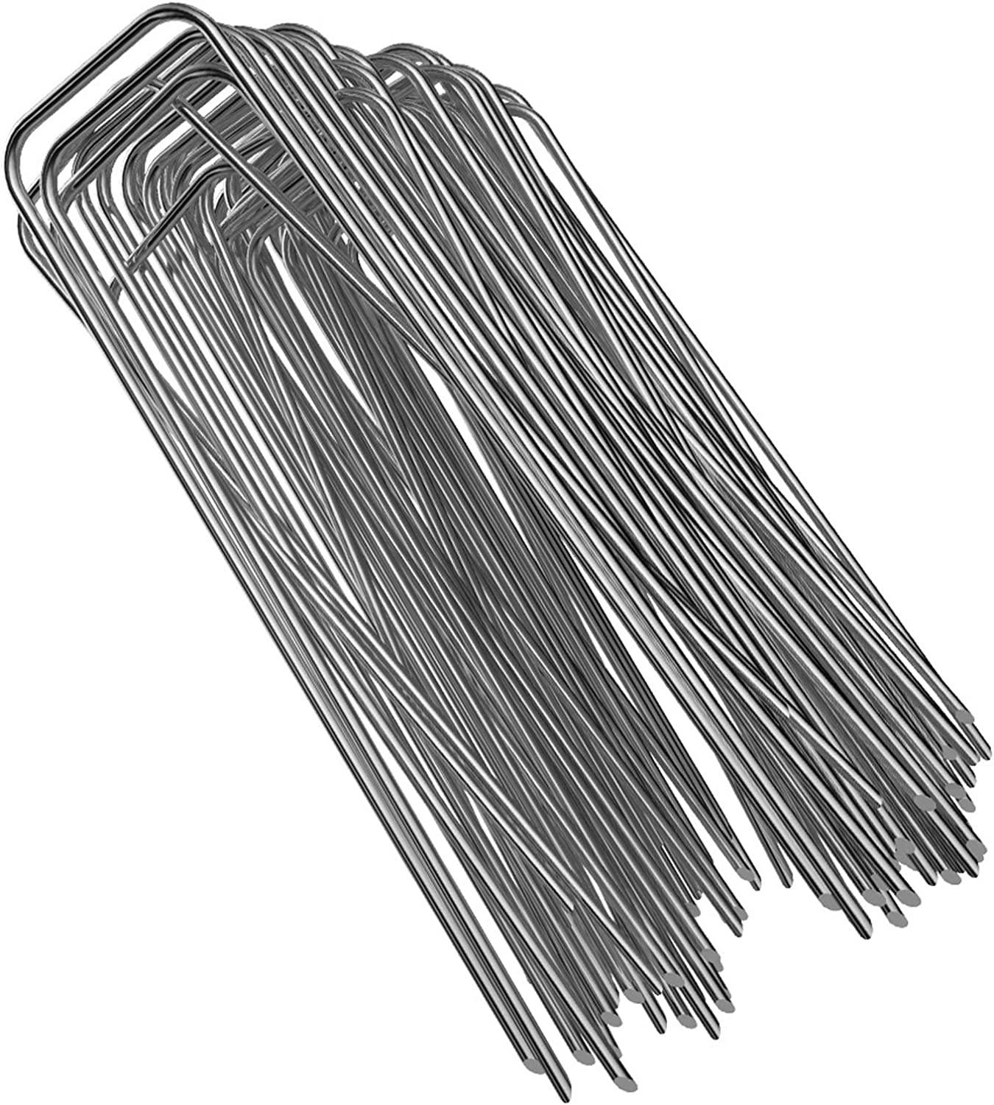
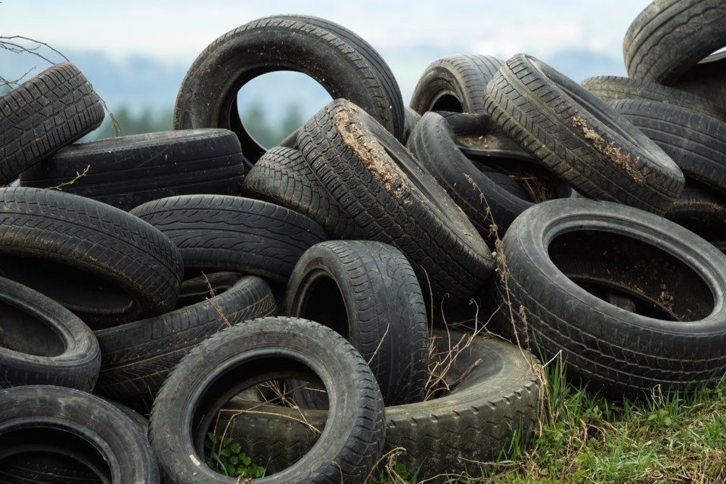
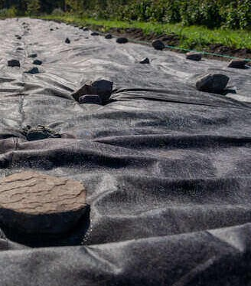
WIND ABATEMENT

Slide 21
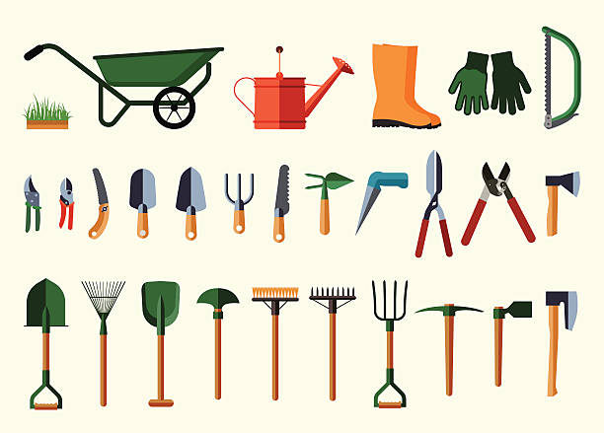
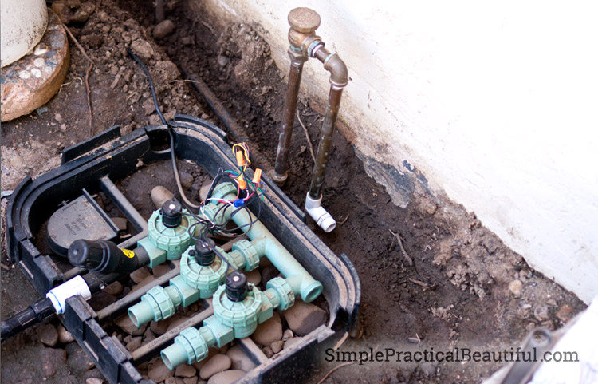
IRRIGATION AND TOOLS
After one last good soaking of the garden remove all nozzles and drain hoses. Store hoses out of the sunlight, it’s best to store indoors if possible.
Automatic system controllers should be turned off. If possible, Loosen end caps on irrigation lines and blow remaining water out of the system. Open zone valves to relieve any water pressure.
Tools should be cleaned and treated with a rust preventative. (I spray with a thin coat of WD40 and wipe off the excess) Store indoors if possible.

Slide 22
FALL IS FOR PLANTING
Contrary to popular belief plants do grow in the winter. If the soil temperature is above 36 degrees roots will continue to grow and develop.
Planting nursery stock that is dormant and has been hardened can be better for the plant. Being in the ground during the harsh winter is better than in a pot above ground.
If you can dig, you can plant Trees, shrubs and perennials late into fall.

Slide 23
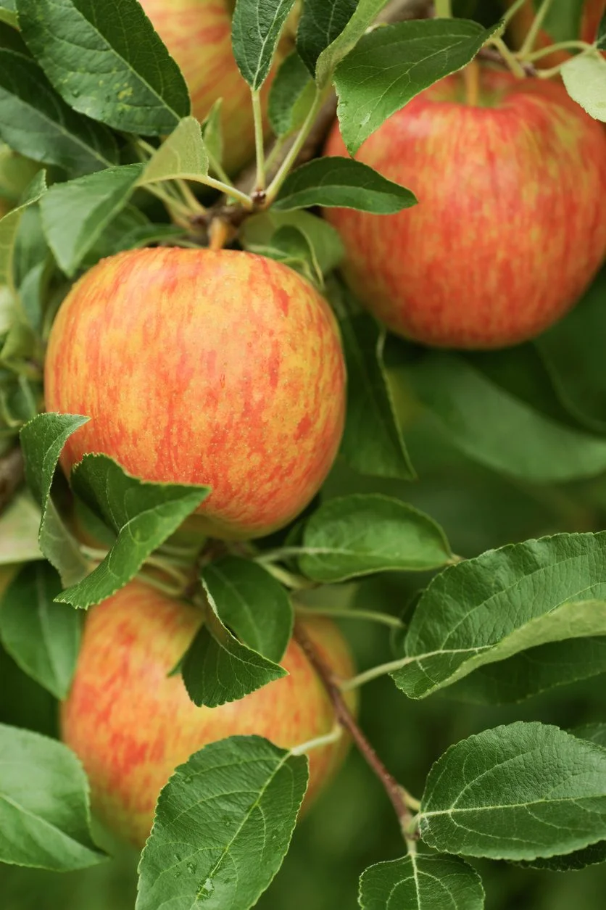
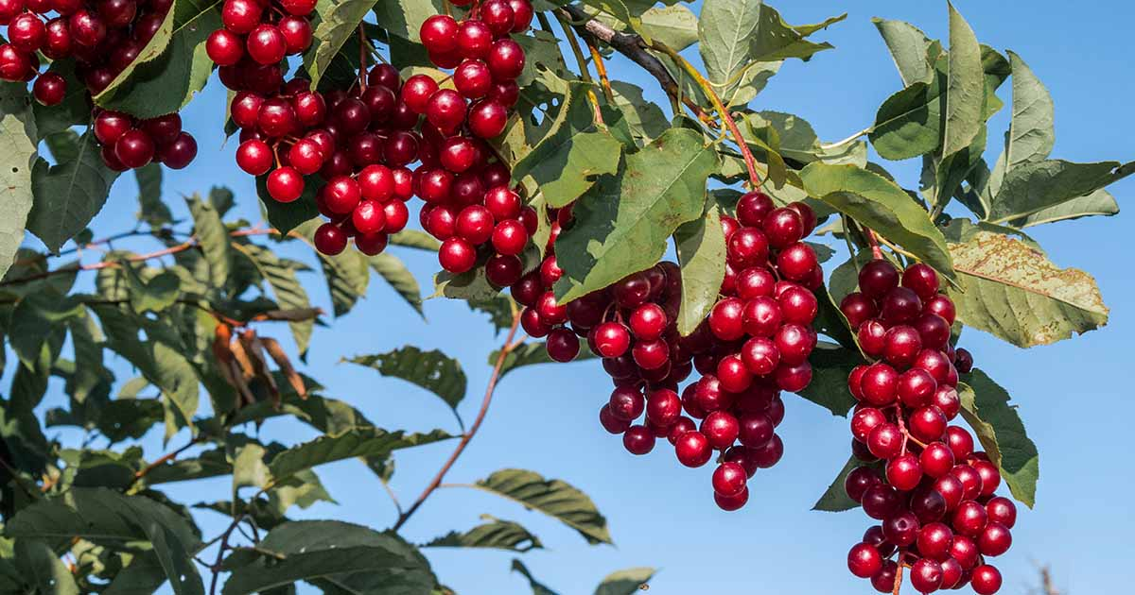
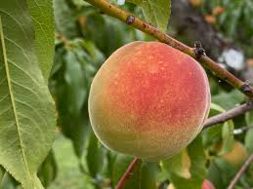
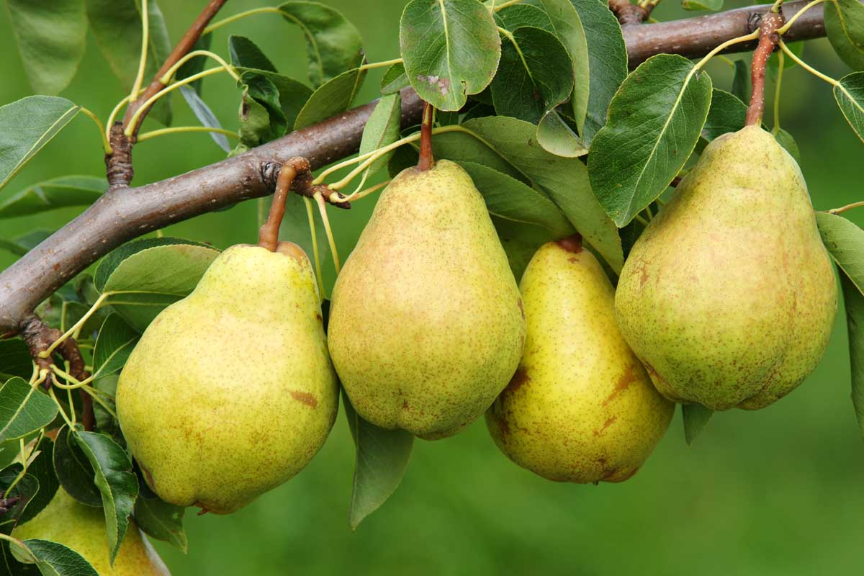
FRUIT TREES FOR FALL
There is no better time to plant fruit trees that are cold hardy for our area. Any USDA zone 5 or below are appropriate. Historically our area was considered a zone 5a (-20 to -15 degrees). However, recently the ratings have changed. Currently most of our area is mixed 5b (-15 to -10) and 6a (-10 to -5). For example, many varieties of these trees.
Apples
Plums
Cherry
Peach
Pear
Fig

Slide 24
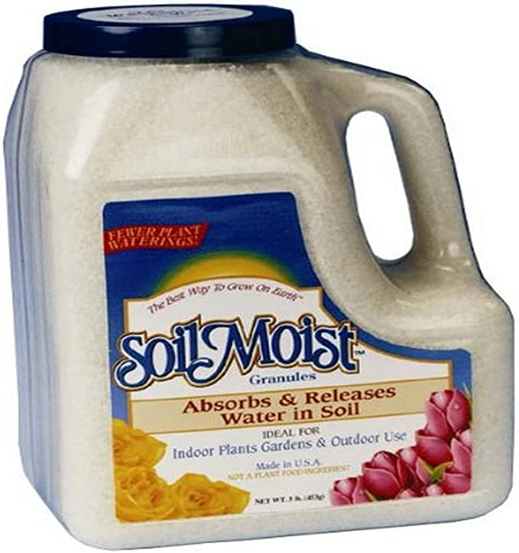
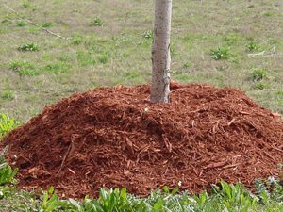
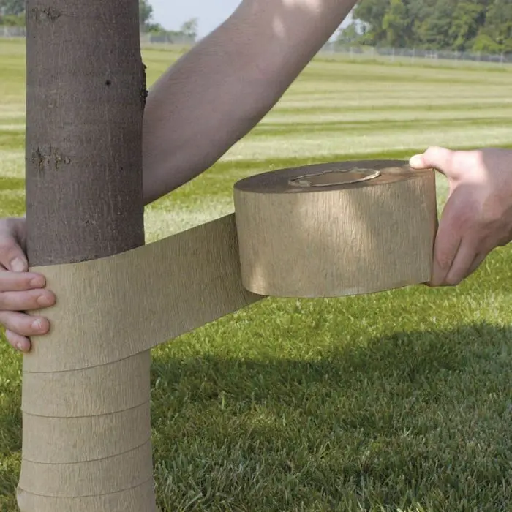
PLANTING CONSIDERATIONS
When planting this late make sure the trees have been climatized outdoors.
Amend planting hole as usual with organic material and polymer water crystals if you choose.
Heavily mulch the planting area.
Tree wrap the trunk for Insulation.

Slide 25
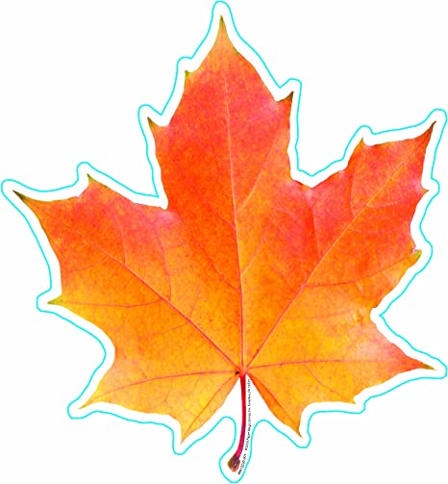
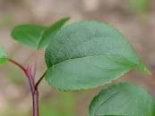
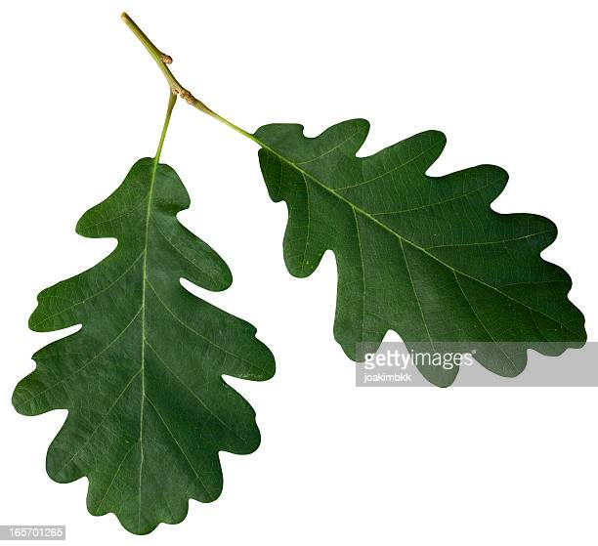
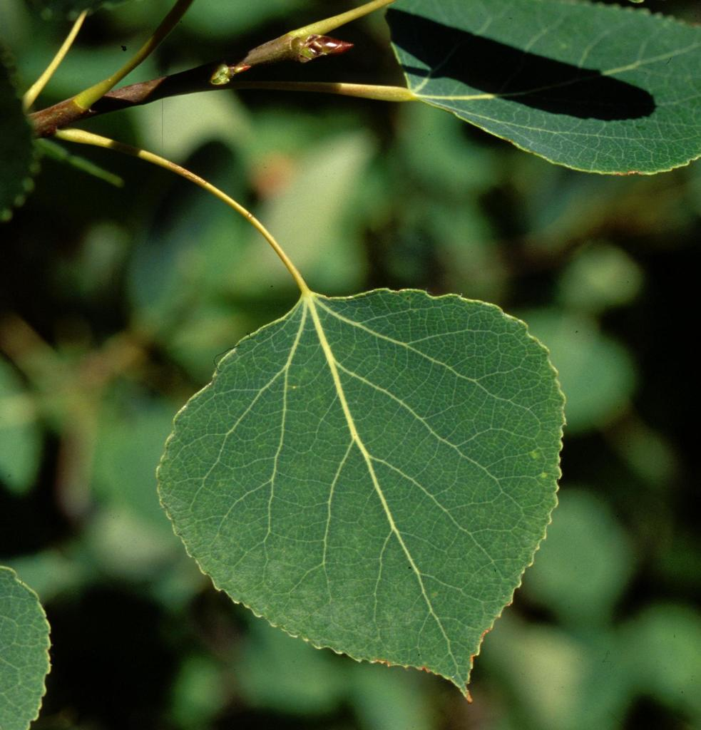
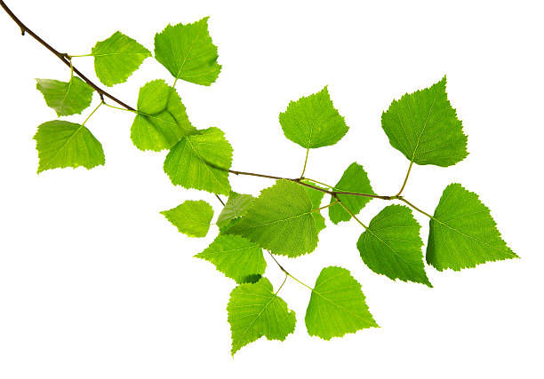
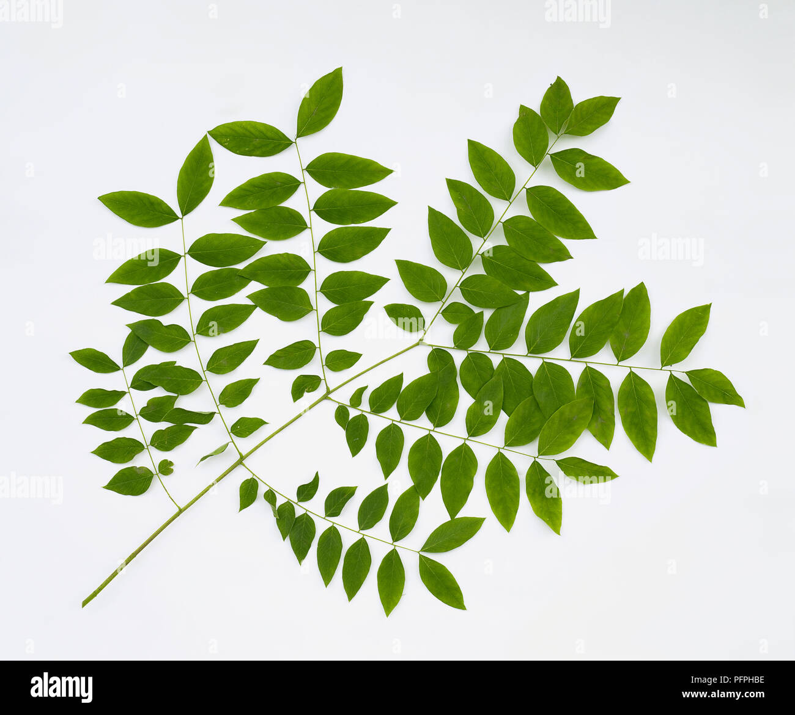
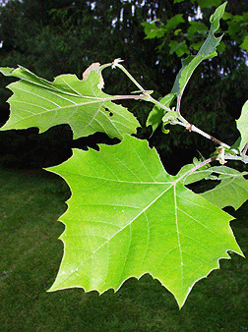
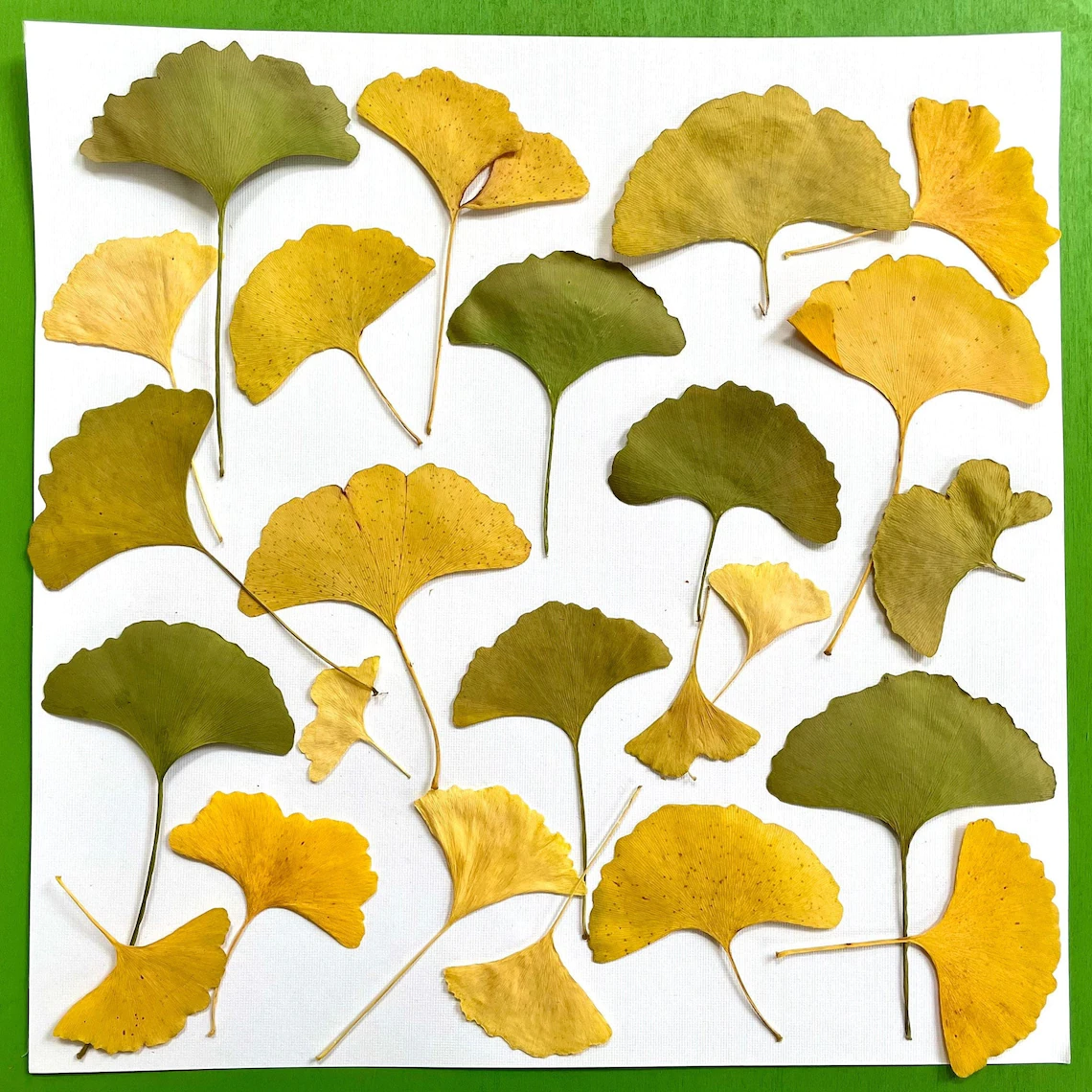
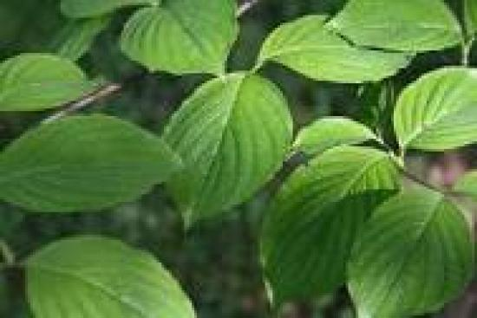
SHADE AND ORNAMENTAL TREES
Many varieties of these:
Maples
Poplars
Oaks
Ginkgo
American Sycamore
Crabapples
Birch
Kentucky Coffee Tree
Dogwood

Slide 26
PLANTING CONSIDERATIONS
When planting this late make sure the trees have been climatized outdoors.
Amend planting hole as usual with organic material and polymer water crystals if you choose.
Heavily mulch the planting area.
Tree wrap the trunk for Insulation.

Slide 27
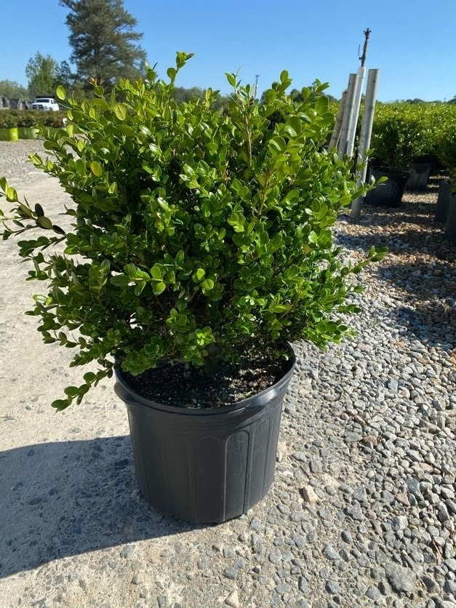
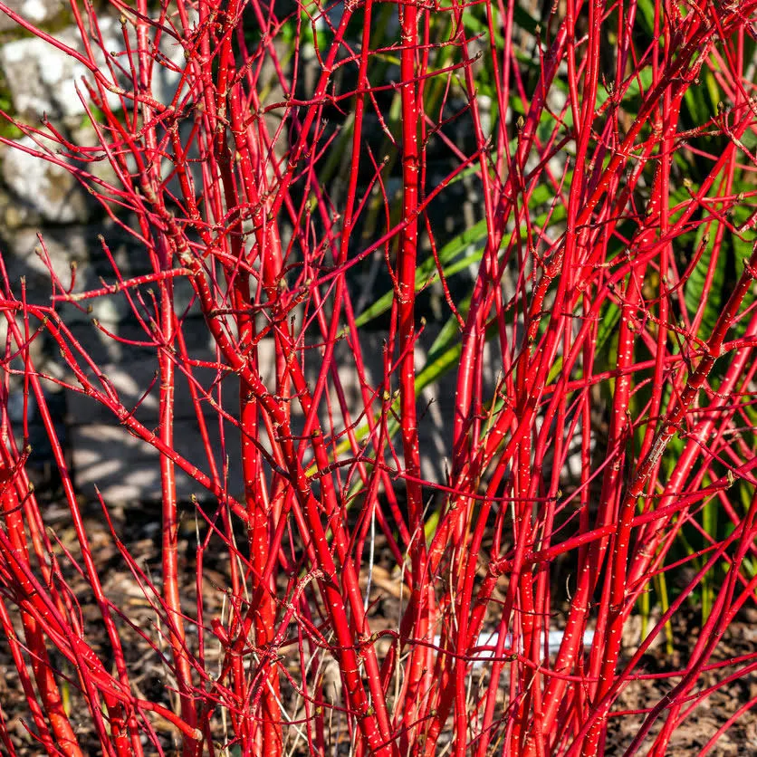
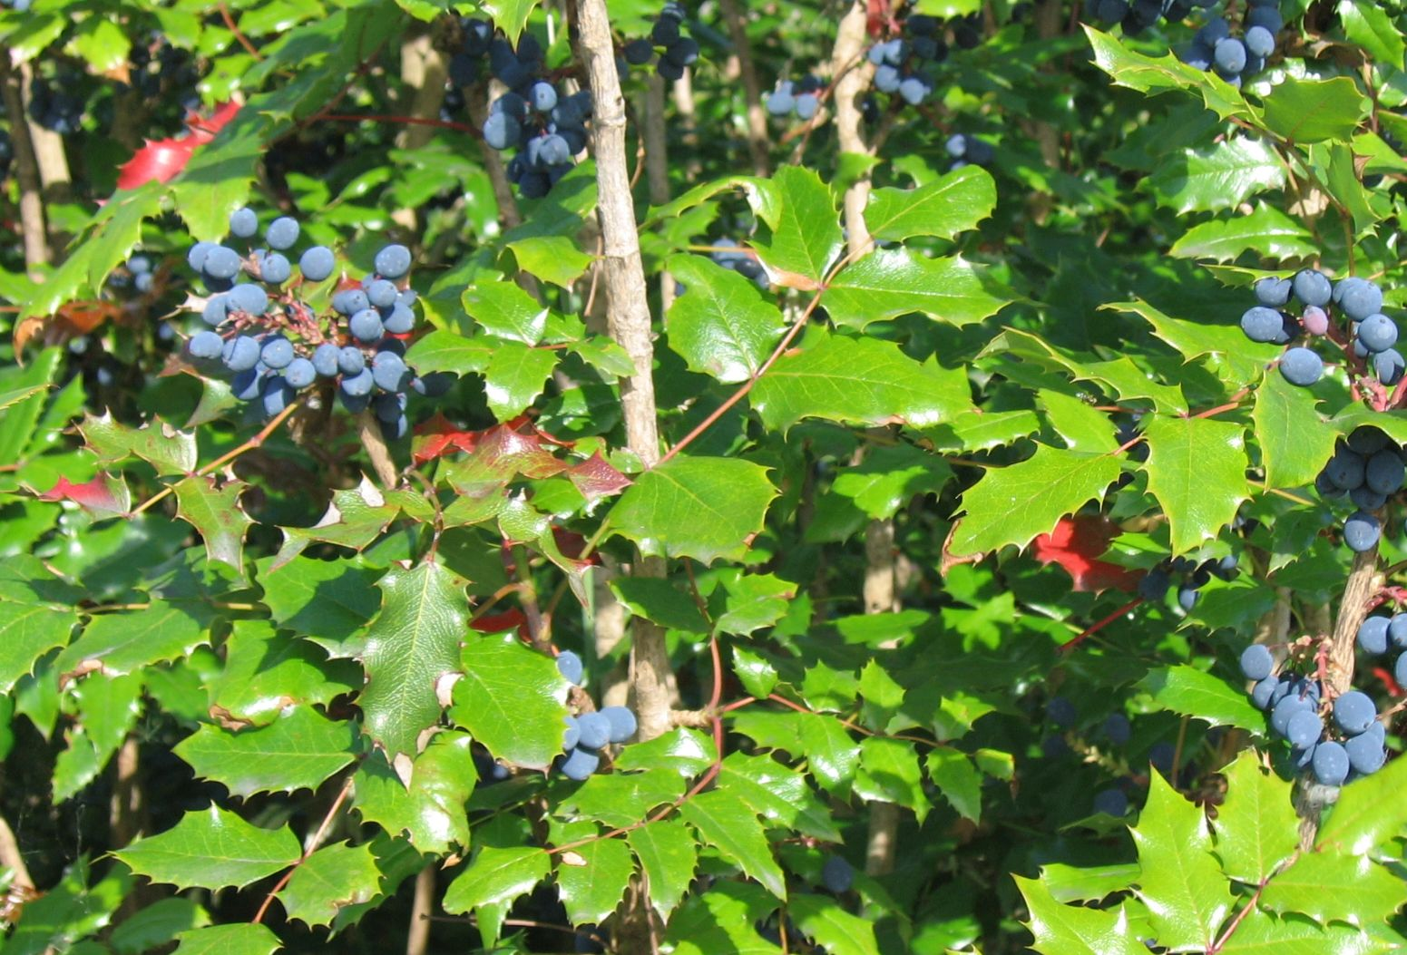
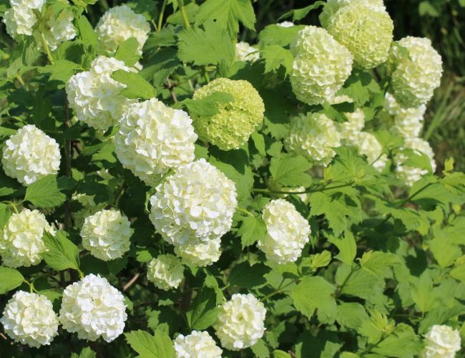
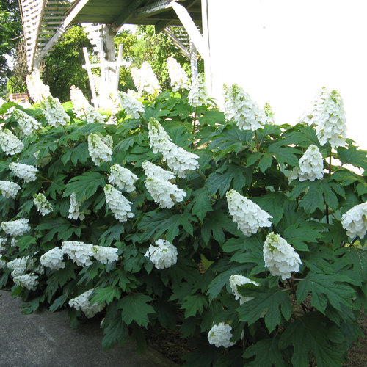
SHRUBS
As with fruit trees and ornamental trees, many shrubs can be planted also. Some favorites include:
Boxwood
Red twig dogwood
Mahonia
Viburnum
Pyracantha
Oakleaf hydrangea
And many more

Slide 28
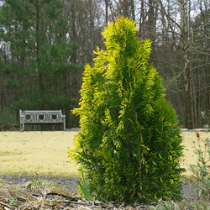
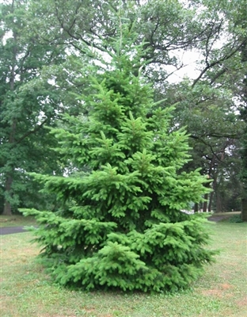
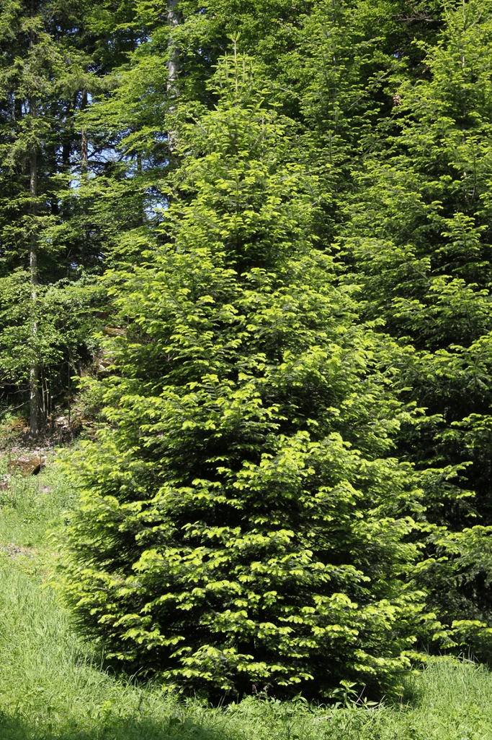
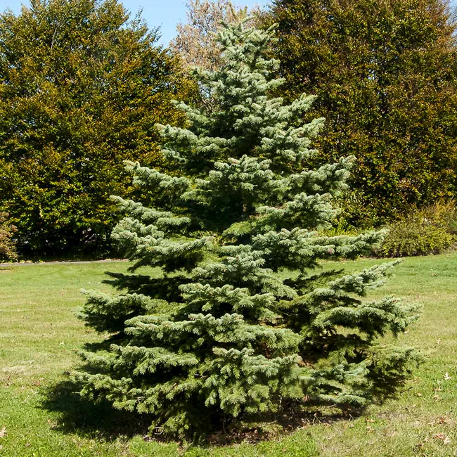
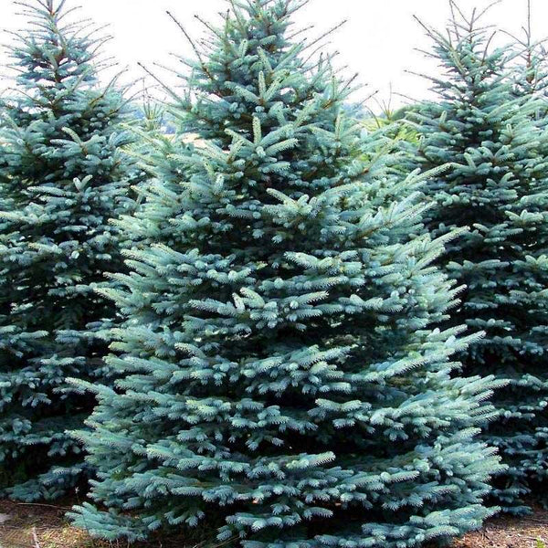
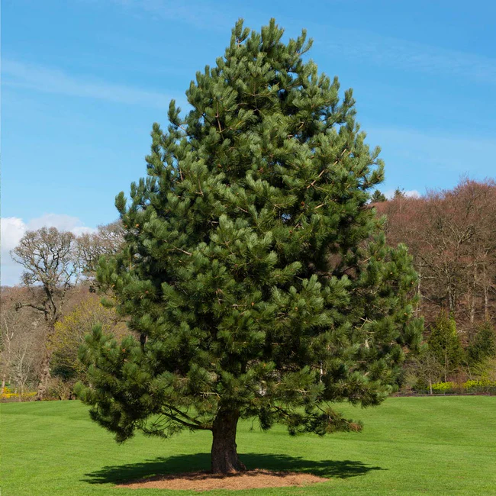
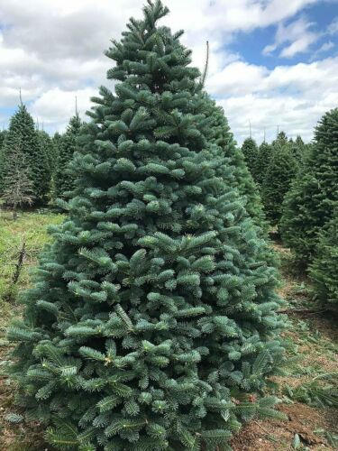
SUITABLE EVERGREENS
Arborvitae
Silver Fir
Colorado blue spruce
Douglas Fir
White Spruce
White Fir
Austrian Pine

Slide 29
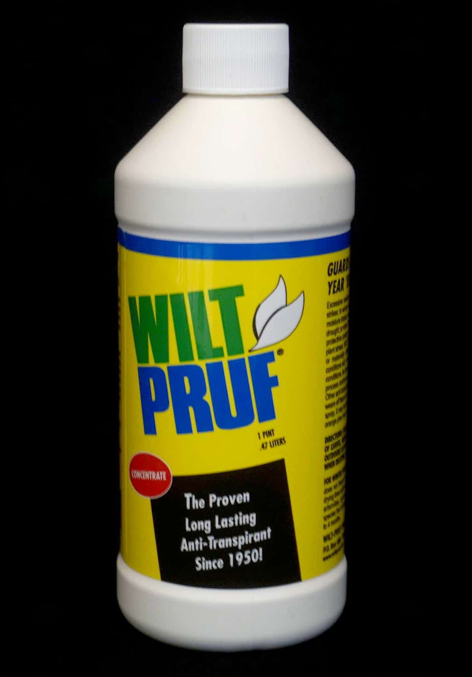
PLANTING CONSIDERATIONS
Evergreens also do well planted in the fall.
It is also important to mulch the planting area.
In addition, it may be a good Idea to use an antidesiccant like Wilt Proof. This slows transpiration for the evergreen and keeps it from drying out.

Slide 30
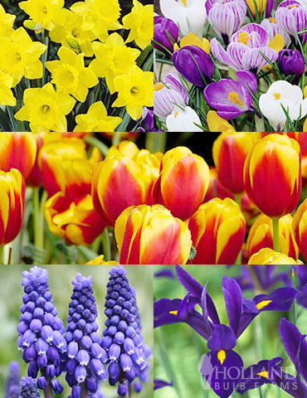
PERENNIALS AND BULBS
All perennials that are rated zone 5 or lower can be planted in the fall.
Fall bulbs can still be planted if it is done soon.
Tulips
Daffodils
Crocuses
Hyacinths
Irises
Alliums

Slide 31
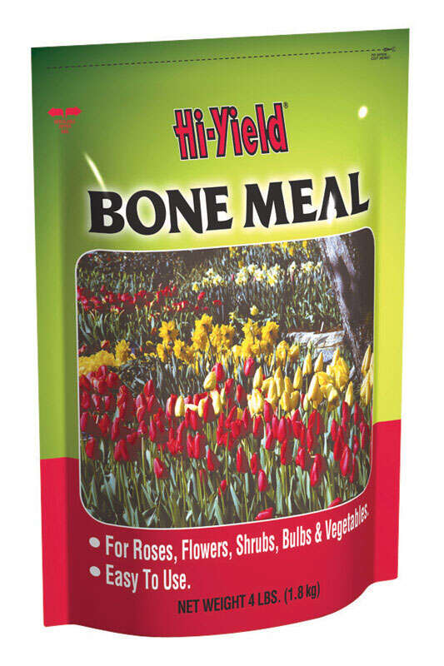
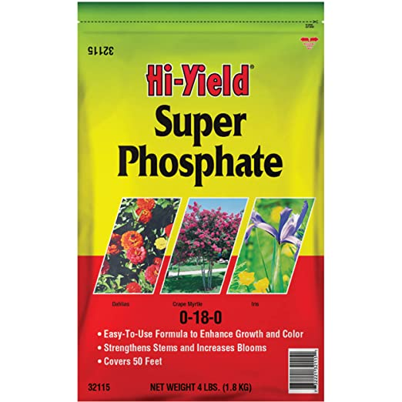
PLANTING CONSIDERATION
Mulch all new bulb and perennials
With the bulbs add a scoop of Superphosphate or bone meal to the bottom of the hole, both offer a good source of phosphorus to encourage root development.

Slide 32
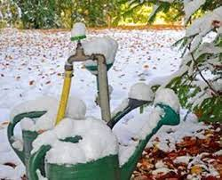
WINTER WATERING
It is imperative that the new plantings be mulched and well watered.
Keep a hose handy, typically our winters are very dry. At least once a month you will want to water the new plantings. Moist soil can also help to insulate the root systems.

Slide 33
CONTACT INFORMATION

